Slide 1
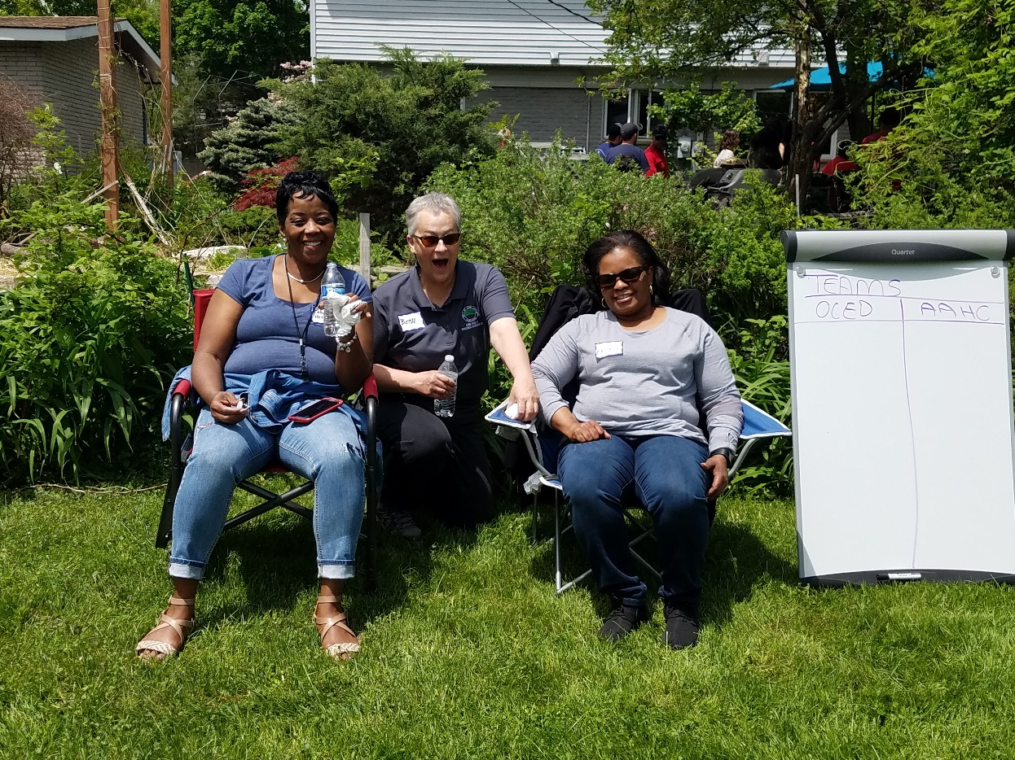
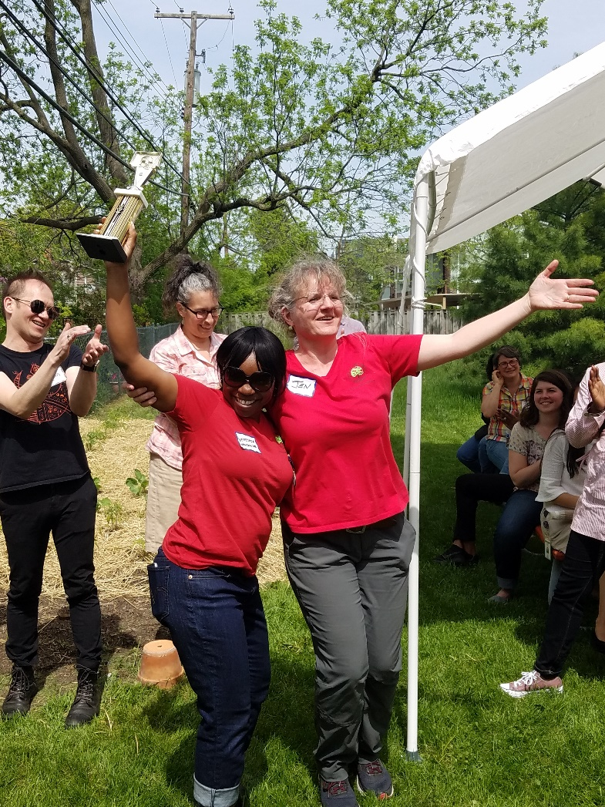
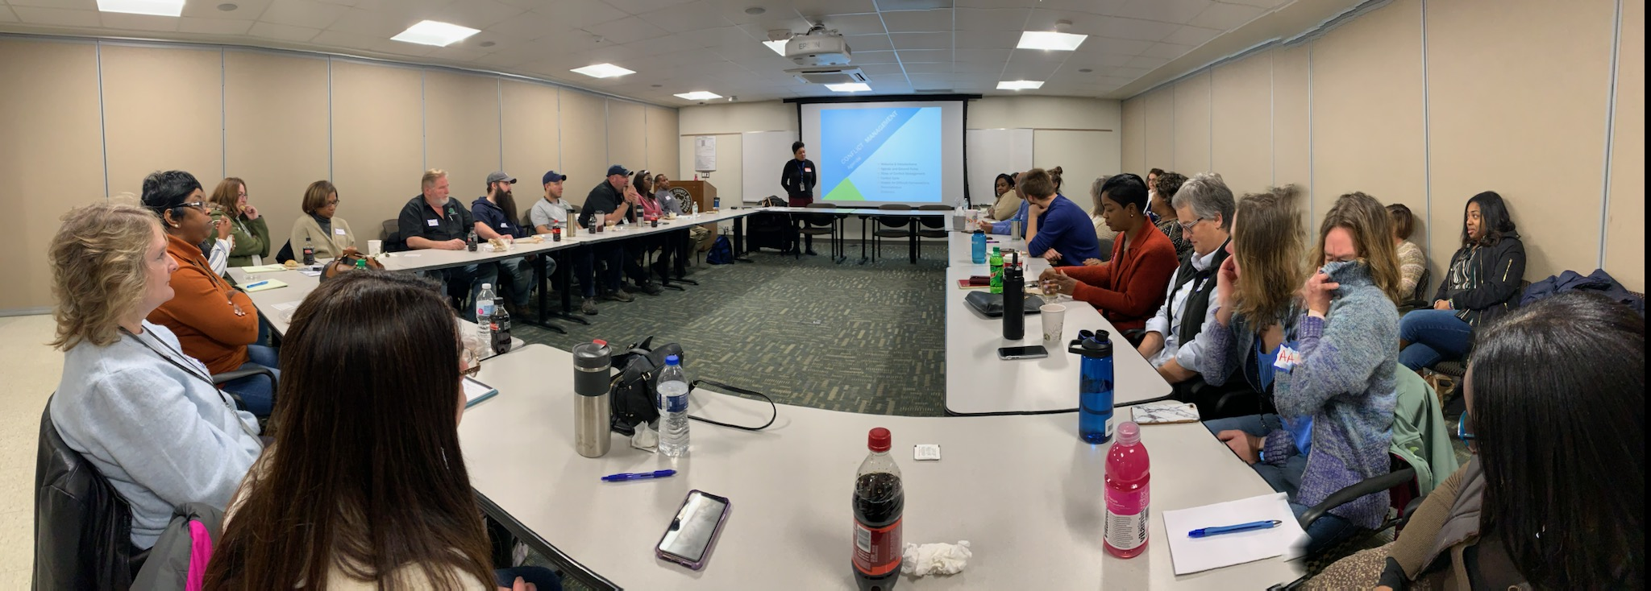
Ann Arbor Housing Commission

Slide 2
Group Questions
Name
2) What is something you would like to learn tonight?

Slide 3
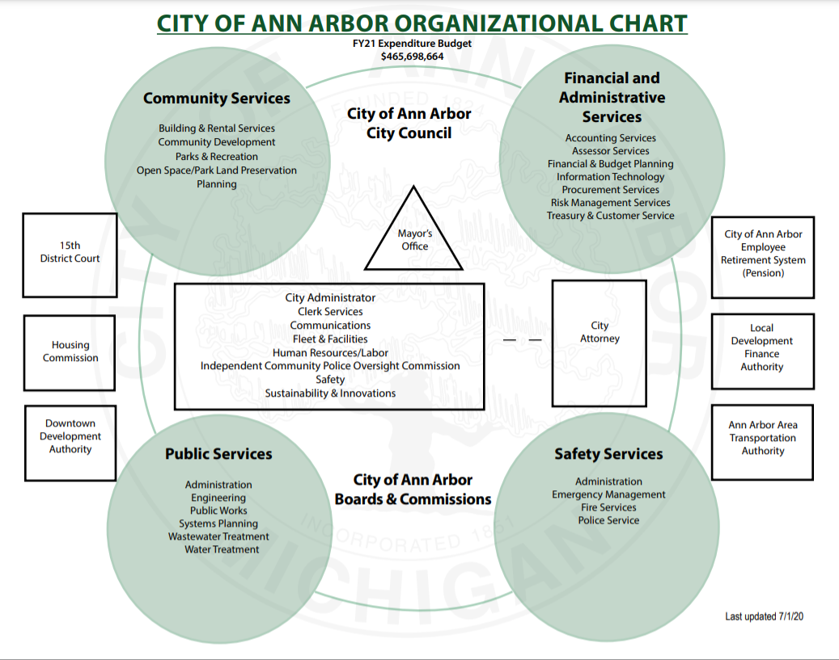
Notes:
Created in 1965

Slide 4
AAHC Mission Statement
Diversity, equity and inclusion is important to the Ann Arbor Housing Commission’s mission of providing affordable housing to low-income individuals and families and is critical to ensuring the well-being of our staff and the communities we serve.
We strive to create an environment where employees are valued and empowered to positively support our mission.
The Ann Arbor Housing Commission will advocate for public and private-sector policies that challenge systems that create inequity, oppression and disparity and work with community partners to bring about positive change.

Slide 5
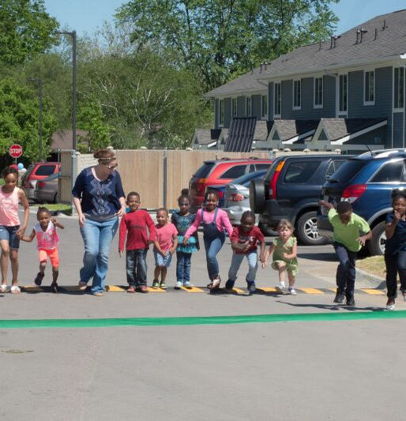
Ann Arbor Housing Commission
01
Affordable Housing Properties
20 properties in the City of Ann Arbor
626 apartments
02
Voucher Programs – Washtenaw & Monroe Counties
2,347 Vouchers
03
Family Self-Sufficiency & Homeownership Programs
100 – 130 FSS participants
21 Homeowners
04
Development
741 Units Under Development by AAHC since 2021
$355,000,000 Total Development Costs
Open House West Arbor – Ribbon Running

Slide 6
GROUP QUESTION
What does Affordable Housing Mean to You?

Slide 7
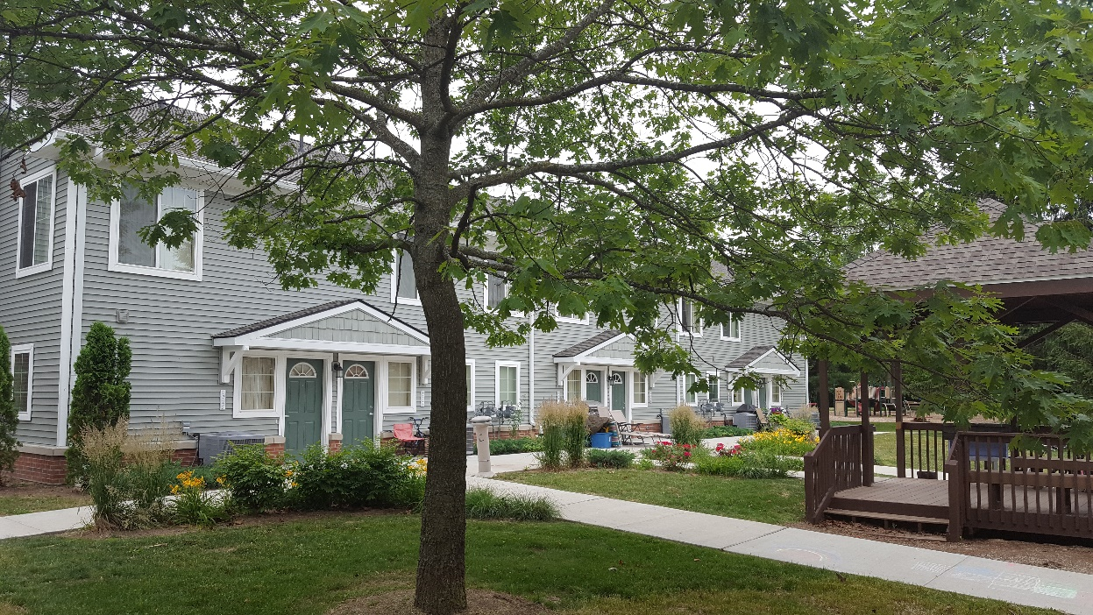
HUD DEFINITION of AFFORDABLE HOUSING
Housing that costs less than 30% of a household’s gross annual income. If housing costs (rent and utilities or mortgage, taxes & utilities) exceed 30%, it is considered a cost burden.
Newer Definition
Housing + Transportation if exceeds 45% of income then cost burden
Notes:
Acknowledge housing is needed in all income ranges, sizes and styles, condos, rental, owner, single family etc.
No difference between Affordable and Worforce - marketing not definition
EITHER Income or age restricted or market rate
Only other clearly defined term is Permanent supportive housing
Income restriction by upper level of income range and inclusive of everything below
Rental or owner but primarily talking about rental today because people with low incomes primarily renters therefore also rent restriction
Miller Manor & Cranbrook Towers 100% low-income due to funding source requirements. Depending on financing, can do mixed-income with or without market rate housing.
Affordable vs. Workforce, Senior 55+, Mixed-income, Mixed Use, Permanent Supportive Housing
In the study – we identified need for 2,711 in A2 up to 60% AMI
If we use the same study to look at the need for units from 60-100% AMI, it would be an additional 3,748

Slide 8
Short History of
Investment & Disinvestment in Public Housing
1937 Federal Housing Act created initial funding for public housing
Public Housing peaked in 1994 with ~1.4 million apartments
1999 Faircloth limit – froze the number of public housing
2012 Rental Assistance Program (RAD) to convert public housing to vouchers
AAHC and YHC have converted all public housing to project based rental assistance
More stable and better funded in the HUD budget than public housing
859,167 public housing
apartments left as of Feb 2026
~$169 Billion is needed to preserve the nations remaining public housing
2026 $3.2 Billion HUD budget

Slide 9
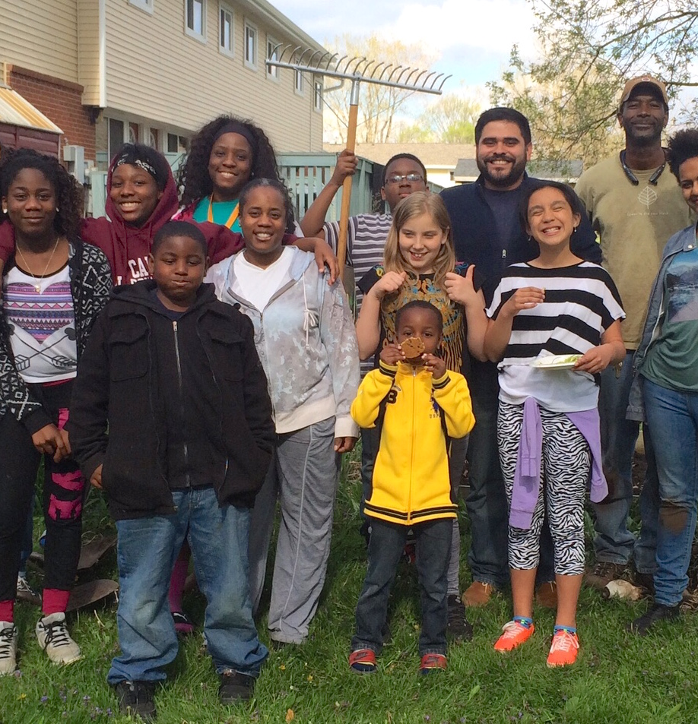
Affordable Housing
AAHC owner & property manager 626 apartments
All have restrictive covenants and/or deed restrictions
86 Studios
340 1-bdr
81 2-bdr
72 3-bdr
30 4-bdr
17 5-bdr
Income Restrictions 30%, 50%, 60% & 80% Area Median Income Eligibility
D&O and EPLI
80% of units have Project-Based Rent Subsidies
Tenants pay 30% of Income as rent
Hikone gardening program

Slide 10
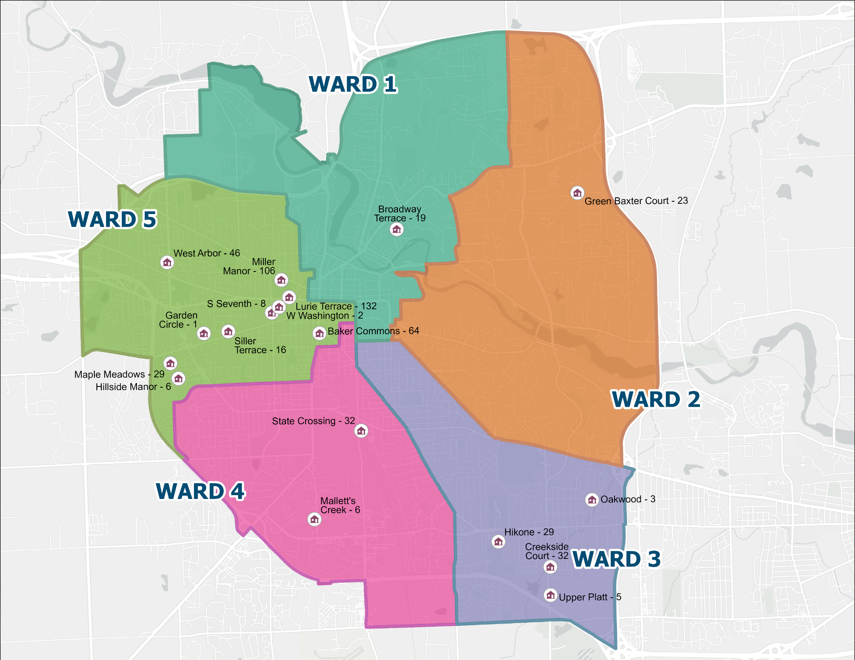

Ann Arbor Housing Commission Properties
Siller Terrace - 16
Dunbar Tower - 63

Slide 11
Permanent Supportive Housing
Housing and Services
Housing First
  No preconditions such as clean and sober
Services are voluntary, free and client-centered
Trauma informed case management
Low barriers to access
  Screen people in, not screen people out

Slide 12
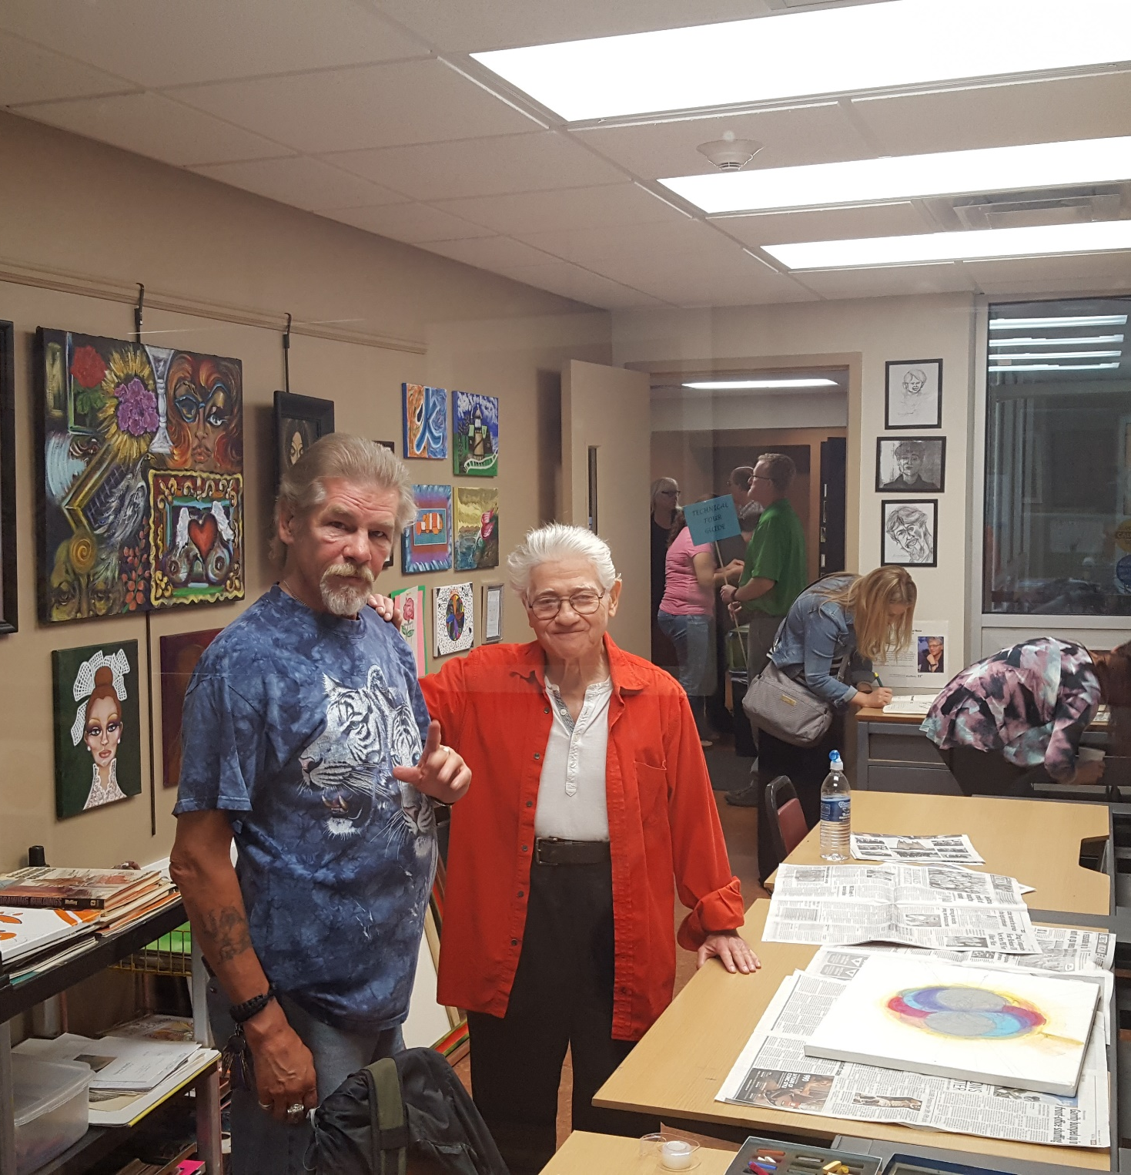
Community Partners
Mental Health and Supportive Services
Client-centered Case Management, Mental Health, Community Building, Crisis Services, Financial Literacy, Jobs, Youth Programs, Support Groups, Eviction Prevention, Quality of Life Services, Resident Council, Art Therapy, Medical Services
Peace Neighborhood Center Food Gatherers
Community Action Network Avalon Housing
Michigan Ability Partners A Brighter Way
UM School of Pharmacy SOS
Catholic Charities VA
Packard Health Clinic MI Works
IHN Alpha House DHHS
Huron Valley PACE
Washtenaw Housing Alliance
Shelter Association of Washtenaw County
Washtenaw County Community Mental Health
Washtenaw County OCED
Resident Art Room at Miller Manor

Slide 13
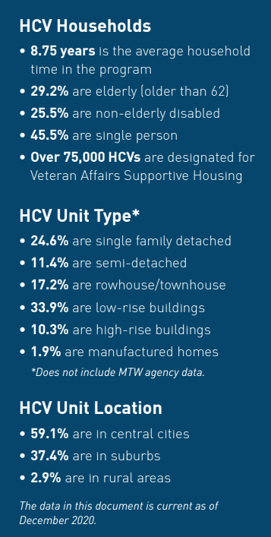
WHAT IS THE HOUSING CHOICE VOUCHER PROGRAM?
U.S. Department of Housing and Urban Development (HUD) rental subsidy program
Intended to be a public/private partnership
Participants are able to find their own housing in the private market
Participants generally pay 30% of their income on housing and the rental voucher pays the balance to the property owner
Administered by public housing agencies (PHAs)

Slide 14
How the Voucher Program Works
Household pulled from waitlist
AAHC determines if eligible
Household attends orientation
Selects a unit in private sector
AAHC confirms unit is affordable for tenant and rent is reasonable
AAHC inspects unit
Landlord signs a lease with the tenant and a contract with AAHC
Landlord receives monthly payment from tenant and AAHC
AAHC Tenant Approval
Tenant Orientation
Unit Affordability
Unit Inspection
Landlord Lease, AAHC Contract, and Rent Subsidy Payment

Slide 15
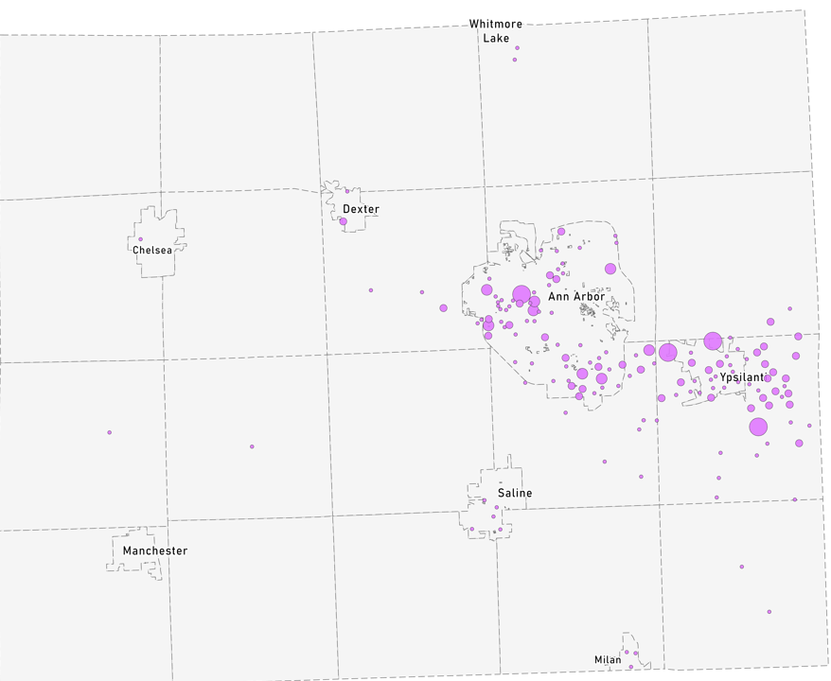
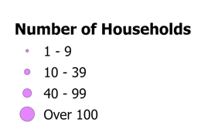
Voucher Programs
AAHC Administers 2,347 vouchers
1,249 Housing Choice Vouchers
278 Veterans Affairs Supportive Housing (VASH)
351 Non-Elderly Disabled Vouchers
32 Family Unification Vouchers
24 Emergency Housing Vouchers
336 RAD Project-Based Vouchers on AAHC properties
6 Foster Youth Initiative
71 Tenant Protection Vouchers
Distribution of All AAHC Vouchers Leased Up in Washtenaw County 6.2025
Notes:
2074 households on 6.2025
Plus 66 Monroe, ~12 VASH Monroe, ~8 Wayne

Slide 16
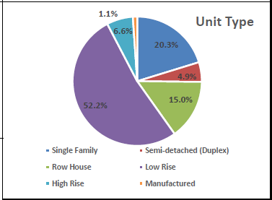
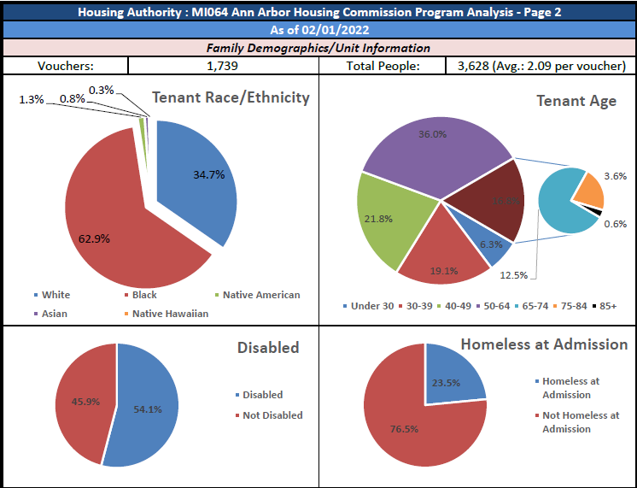
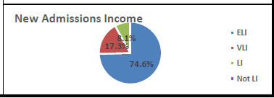
Head of Household
AREA MEDIAN INCOME (AMI)
ELI = Extremely Low Income - under 30% AMI
VLI = Very Low Income – 31% - 50% AMI
LI = Low Income – 51% - 80% AMI
39% of AAHC Voucher participants 18 years old or less

Slide 17
GROUP QUESTION
What is the annual household income of households that you think of, when you think about households who struggle to find housing they can afford in Ann Arbor?
Is it same/different for Washtenaw County?

Slide 18
2025 Ann Arbor Area Median Income
Area Median Income | 1 Person | 2 Person | 3 Person | 4 Person | 5 Person
30% | $26,460 | $30,240 | $34,020 | $37,770 | $40,800
50% | $44,100 | $50,400 | $56,700 | $62,950 | $68,000
60% | $52,920 | $60,480 | $68,040 | $75,540 | $81,600
80% | $70,560 | $80,640 | $90,720 | $100,720 | $108,800
100% | $88,200 | $100,800 | $113,400 | $125,900 | $136,000
120% | $105,840 | $120,960 | $136,080 | $151,080 | $163,200
Ann Arbor Primary Metropolitan Statistical Area includes all of Washtenaw County – Median Family Income = $125,900 USA = $104,200
HUD places the Area Median Income into the 100% AMI 4-person household slot, and all other incomes are a formula based off that number
Notes:
2021 $106,600
As of January 1, 2026, Michigan's minimum wage is $13.73 per hour ($28,558), rising from $12.48, according to Michigan's Improved Workforce Opportunity Wage Act. The rate is set to increase to $15.00 per hour ($31,200) by January 1, 2027, followed by annual inflation-based adjustments

Slide 19
2025 Affordable Monthly Housing Costs
Based on Spending 30% of Income
Area Median Income | 1 Person | 2 Person | 3 Person | 4 Person | 5 Person
30% | $661 | $756 | $850 | $944 | $1,020
50% | $1,102 | $1,260 | $1,417 | $1,573 | $1,700
60% | $1,323 | $1,512 | $1,701 | $1,888 | $2,040
80% | $1,764 | $2,016 | $2,268 | $2,518 | $2,720
100% | $2,205 | $2,520 | $2,835 | $3,147 | $3,400
120% | $2,646 | $3,024 | $3,402 | $3,777 | $4,080
MSHDA published Maximum rents for Low Income Housing Tax Credit Program

Slide 20
Federal Poverty Level
Family Size | 2026 Poverty Threshold Income
Individuals | $15,960
2 people | $21,640
3 people | $27,320
4 people | $33,000

Slide 21
How are low-income residents impacted by the City of Ann Arbor’s Housing Market?

Slide 22

Housing Units and Rent
*Affordable Units <= 60% AMI
Year
Median Rent
Total Housing Units
Year
Total Number of Housing Units
Average Rent
Notes:
TC
This graph shows all of the County's housing stock – both rental and owner-occupied – year over year from 2012 to 2021. During this 9-year span, the County gained an additional 10,226 housing units.
The small blue segment shows vacant housing units in the County, which in 2021 was only 8,827 units -- which represents only 6% of the total housing stock that year.
Median rent was $921 in 2012 and rose to $1,225 by 2021 – a 33% increase over a 9- year period.
The yellow line running horizontal toward the bottom of the graph shows the # of affordable rental units in the County from 2016 through 2021, pulling from the Affordable Housing Dashboard that was launched at OCED in 2015 to track progress against the goals set by the County's 2015 Housing Affordability and Economic Equity Analysis.
Affordable is defined here (and on the affordable housing dashboard) as income and rent restricted for households with incomes at or below 60% of Area Median Income.
The number of affordable units in Washtenaw has decreased by a net of 758 units; because while while we’ve had 233 new affordable units come online since 2015, during this same time span we have lost 991 units that have converted to market rate.
In 2021 – we had around 4,554 affordable units, which makes up just under 3% of the County’s total housing units.
Reference to Affordable Housing Dashboard: https://www.arcgis.com/apps/dashboards/bf43a42c68ec45539908236f6c63e35b

Slide 23
Fair Market Rents
Washtenaw County
1-bdr FMR in FY 1985 – $448
1-bdr FMR in FY 2005 – $713
1-bdr FMR in FY 2025 – $1,346
Source: U.S. HUD.
Notes:
Based on federal analysis of American Community Survey of all housing types, not including housing built in last 2 years, and not including subsidized housing.
Used for several federal programs, effective federal fiscal year of Oct 1st

Slide 24
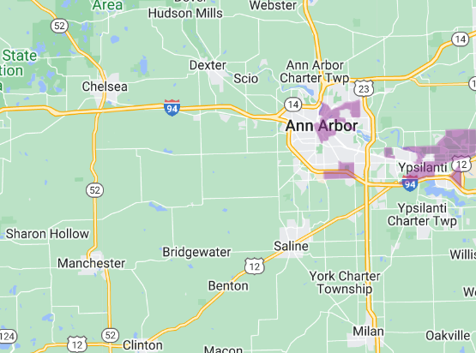
Poverty by
Census Tract
Qualified Census Tract: 50 percent of households with incomes below 60 percent of the Area Median Gross Income (AMGI) or have a poverty rate of 25 percent or more.
Source: 2023 HUD Office of Policy Development & Research, Qualified Census Tracts
Notes:
Qualified Census Tract: 50 percent of households with incomes below 60 percent of the Area Median Gross Income (AMGI) or have a poverty rate of 25 percent or more.

Slide 25
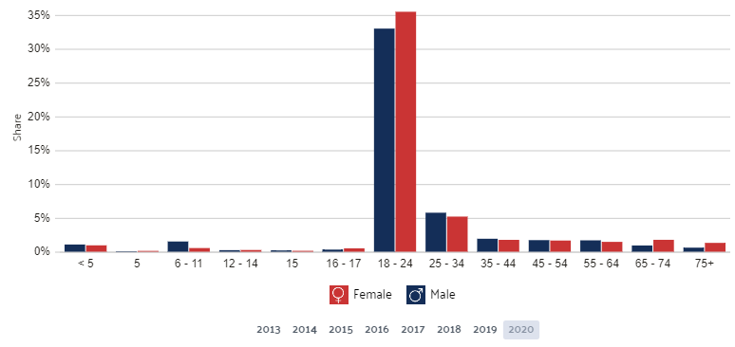
Ann Arbor 2020 Poverty by Age and Gender
Source: DATA USA, Ann Arbor, 2020

Slide 26
Major Area Employers
Company Name | Organization Type | # of Employees
University of Michigan | Public university and health care system | 37,400 – 37,499
Trinity Health Michigan | Health care system | 5,500 – 5,599
Ann Arbor Public Schools | Public school district | 2,700 – 2,799
VA Ann Arbor Healthcare System | Health care system | 2,700 – 2,799
IHA Health Services Corporation | Multi-specialty physician group practice | 1,600 – 1,699
Washtenaw County Government | County government | 1,300 – 1,399
Eastern Michigan University | Public university | 1,300 – 1,399
Toyota Motor Research & Development | OEM research | 1,200 – 1,299
Domino’s Pizza | Corporate headquarters | 1,200 – 1,299
Faurecia Interior Systems | Automotive component manufacturer | 900 – 999
RealTruck | Automotive component manufacturer | 900 – 999
Ford Rawsonville Components Plant | Automotive component manufacturer | 800 – 899
City of Ann Arbor | City government | 700 – 799
KLA Corporation | R&D semiconductor research center | 700 – 799
Zingerman’s Family of Businesses | Food production | 700 – 799
ProQuest | Data and information | 600 – 699
Ypsilanti Community Schools | Public school district | 600 – 699
JAC Products Inc. | Automotive component manufacturer | 500 – 599
Martinrea Bishop Circle Assembly | Automotive component manufacturer | 400 – 499
Stellantis | OEM research | 400 – 499
Source: Ann Arbor SPARK (January 2025)

Slide 27
U of M Enrollment and Ann Arbor Population
Decennial Census data
Sources: University of Michigan Office of the Registrar and U.S. Census Bureau.
Notes:
Decennial Census except 2017 ACS estimates

Slide 28
U of M enrollment in 1999 – 37,846
U of M enrollment in 2018 – 46,716
U of M enrollment in 2025 – 53,488
Sources: University of Michigan Office of the Registrar and Housing.
Notes:
Students note 1.1 annual increase is fairly standard for U of M.
2007-2008 to 2017-2018 was 1.3%.
Info on
UM housed 37% of its undergraduates in academic years 2000-2001 through 2011-2012; that figure has
since fallen to 31% in the 2018-2019 academic year.

Slide 29
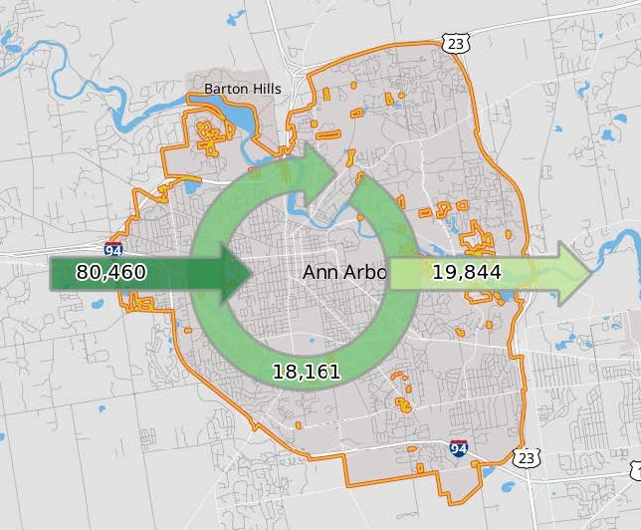
Commuting Patterns
80,460 commute in for jobs
18,161 live and work in Ann Arbor
19,844 commute out for jobs
Source: On the Map 2021
Notes:
2017 On the Map

Slide 30
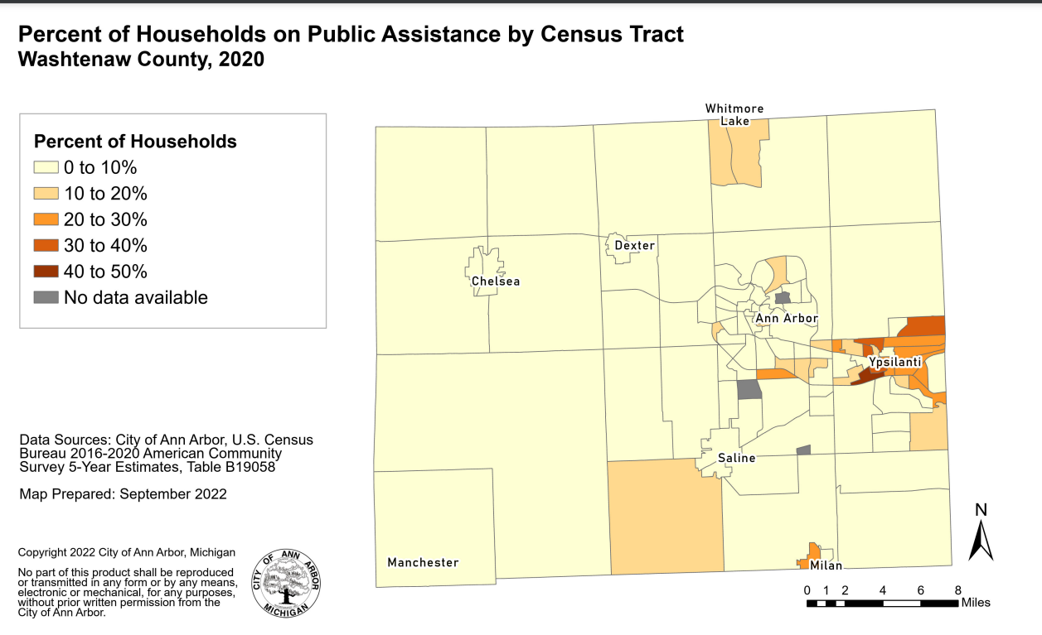
Notes:
Martin Prosperity’s Institute's 2015 report – Ann Arbor Metro Area is the 8th most Economiclly Segregated City
Monroe MI 2nd most economically desegregated city.

Slide 31
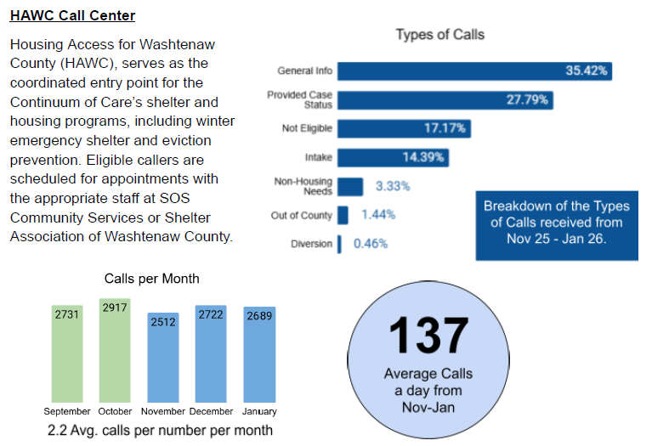
Notes:
24.3% Diversion
22.9% Intake/Assessment
21.4% CERA
17.1% non-housing need
11.5% case status

Slide 32
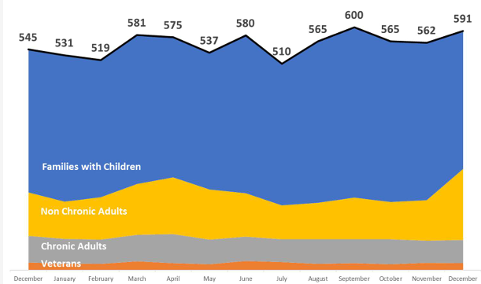
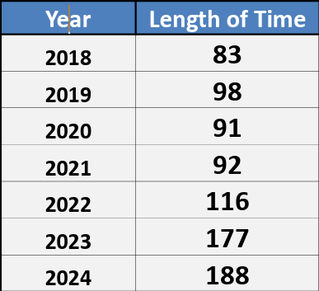
People Experiencing Homelessness In Washtenaw County
December 2023 to December 2024 in Continuum of Care System
Average length of time until housed in days
Notes:
Family number includes each person in household. About 2500 by name households in 2021
A homeless individual or head of household with a disability that meets the HUD definition of a disability who lives in a place not meant for human habitation, a safe haven, or in an emergency shelter AND
An unaccompanied homeless person (a single homeless person who is alone and is not part of a homeless family and not accompanied by children) with a disabling condition such as a diagnosable substance abuse disorder, a serious mental illness, or a developmental disability.
A single individual (or head of household) with a disabling condition who has experienced homelessness for longer than a year, during which time the individual may have lived in a shelter, Safe Haven, or a place not meant for human habitation.

Slide 33
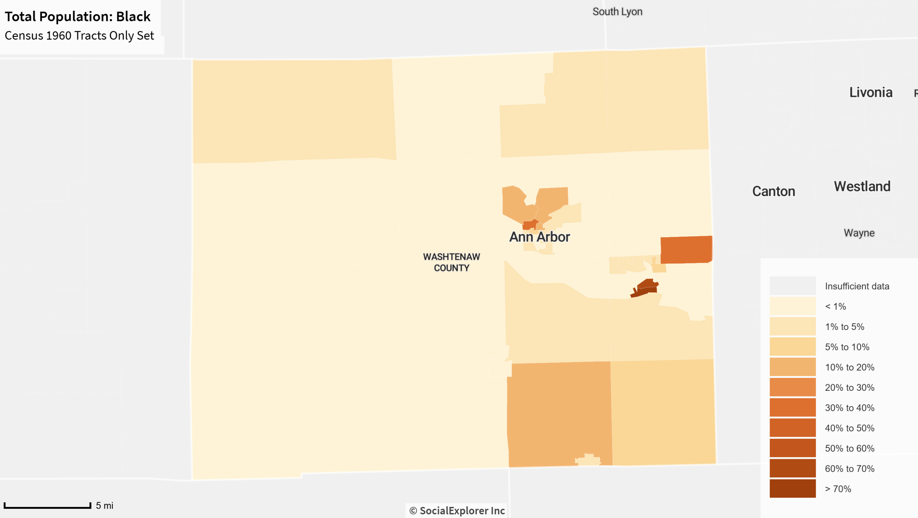
Notes:
Washtenaw County is currently the 8th most segregated county by race in the United States according to the Martin Prosperity’s Institute's 2015 report – Segregated City, The Geography of Economic Segregation in America’s Metros. As Ann Arbor has gentrified, shift in where Black families and other people of color are living and where white families are living. White families tend to move to Western part of Washtenaw County and People of Color tend to move to Eastern part of the county
Washtenaw 74% white Black 13% amer indian/Alaskan .04% Asian 9% 2 or more races 3% Hispanic 5%
Michigan 80% white Black 14% amer indian/Alaskan 1% Asian 3% 2 or more races 2% Hispanic 5%
Washtenaw 15% poverty, Michigan 15% poverty
Poverty rate in Michigan
percent white 8% black 24% other 11% Hispanic 23%
number white 609,400 black 316,600 other 64,600 Hispanic 118,700
Census - % Black only population in city of Ann Arbor:
1980 – 9.3%
1990 – 8.9%
2000 – 8.8%
2010 – 7.7%
ACS 2016 – 7.3%
(not more that “two or more races” in effect starting in 2000.

Slide 34
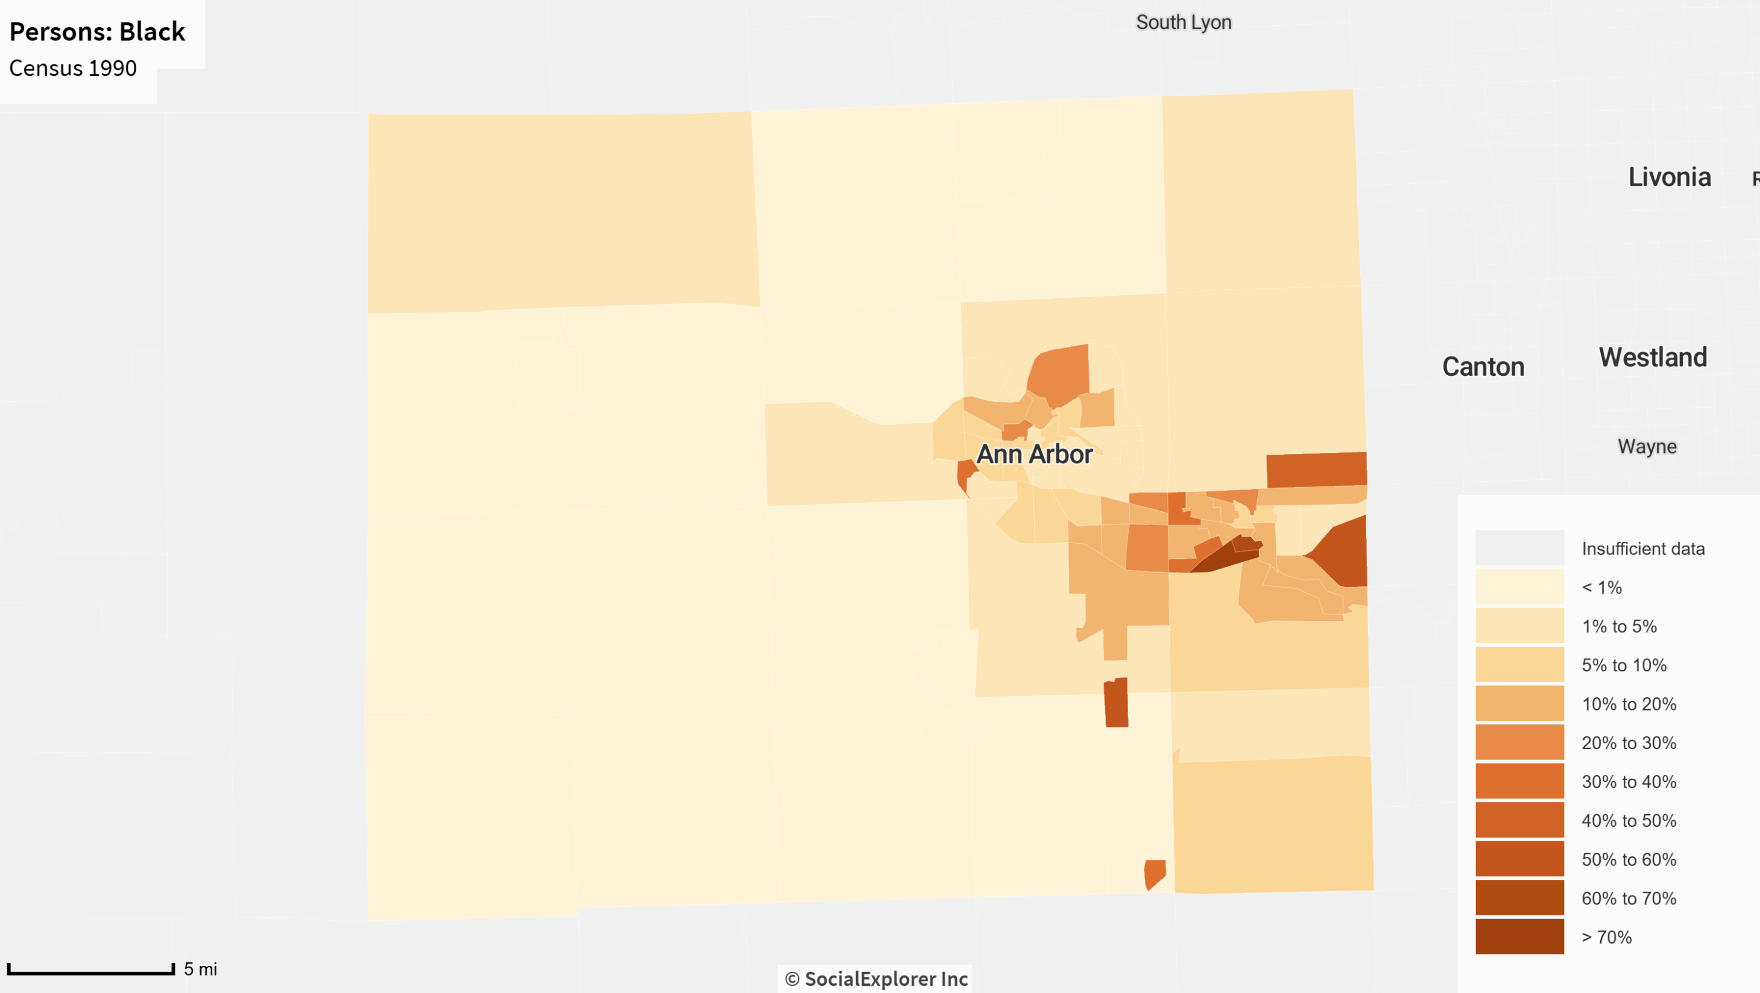

Slide 35
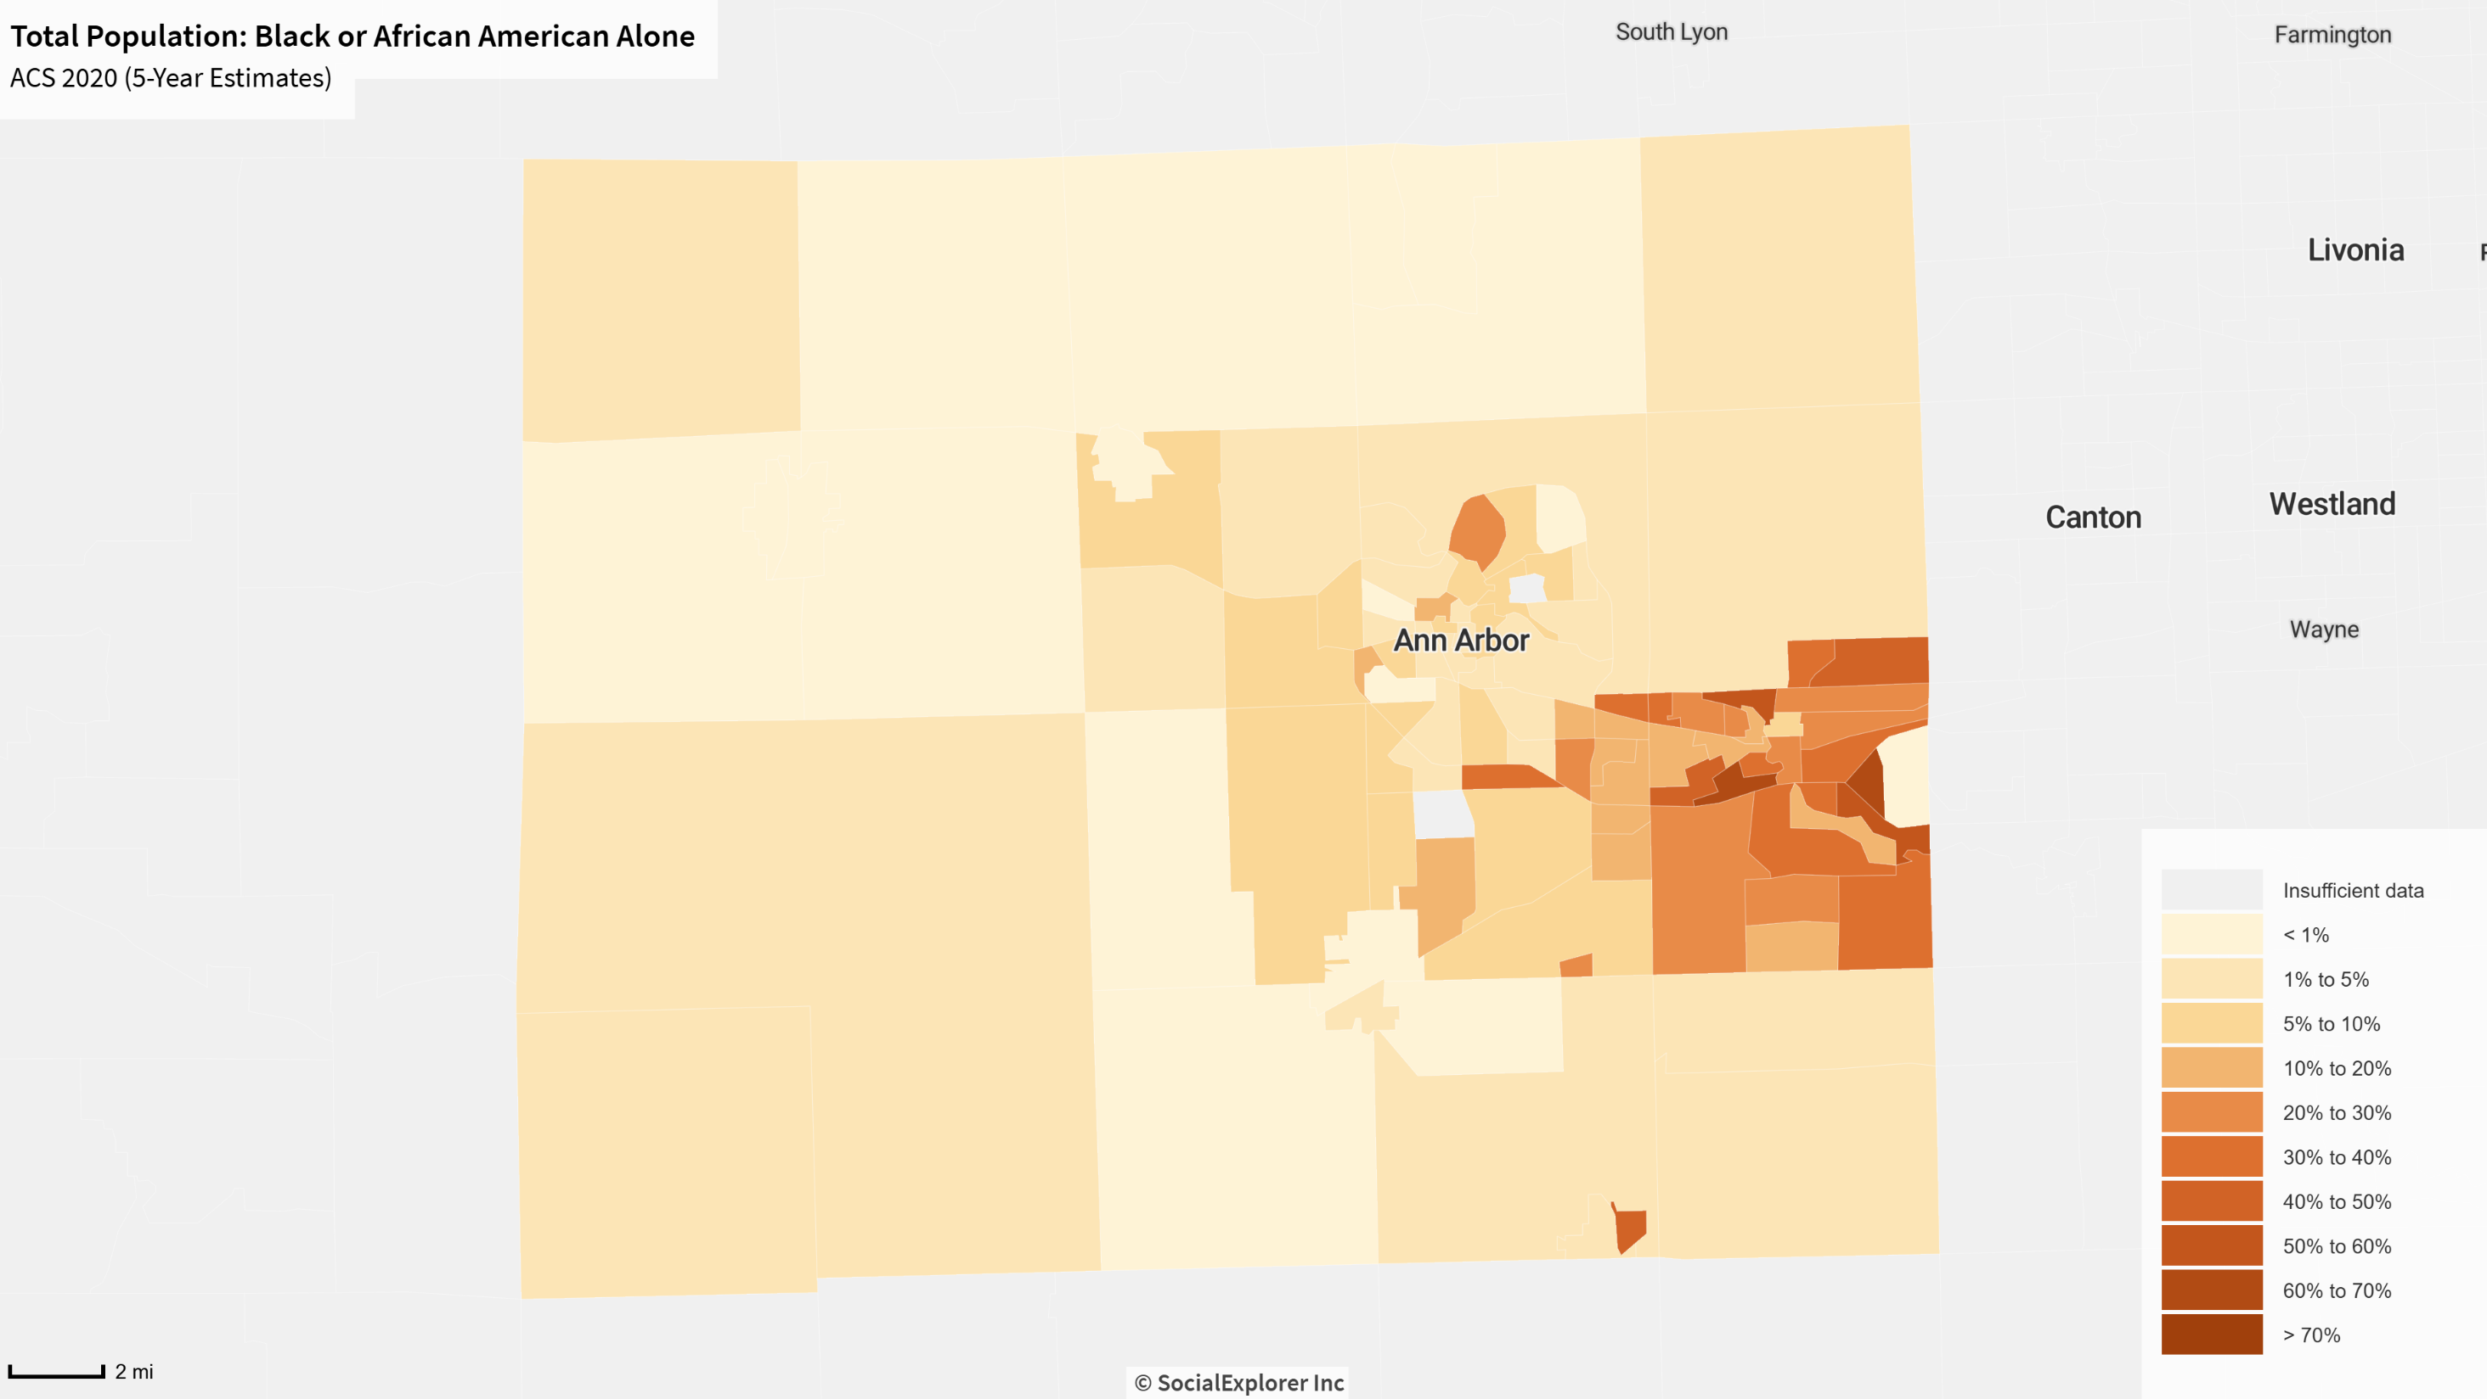

Slide 36
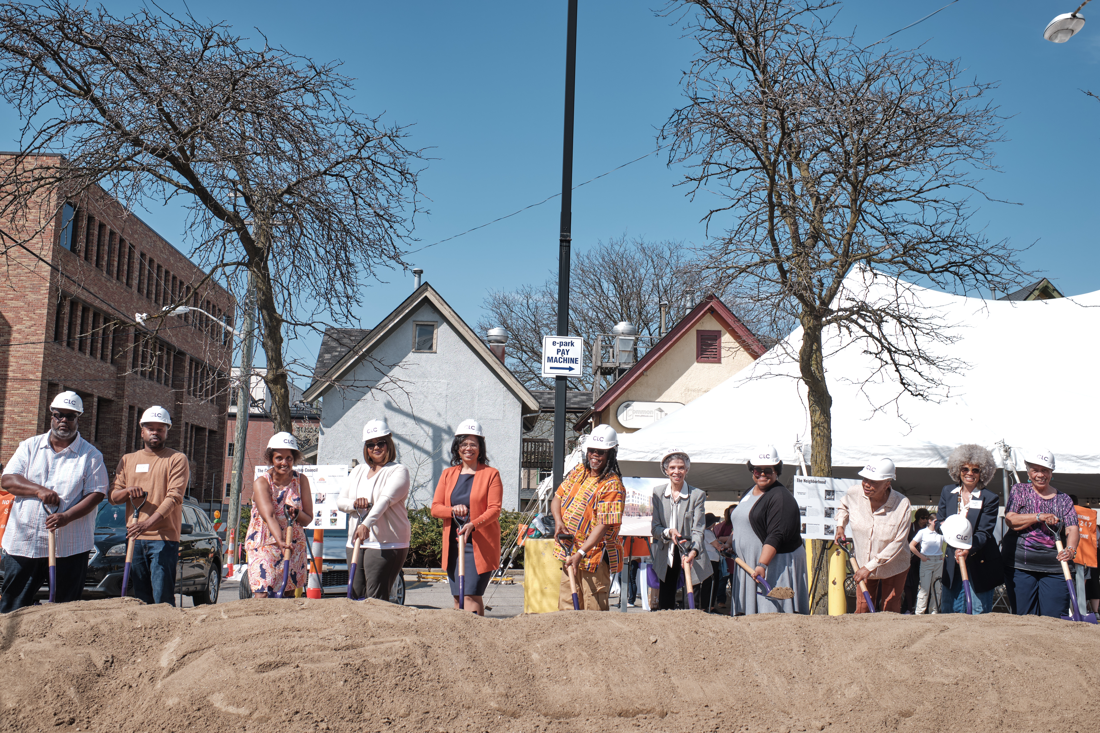
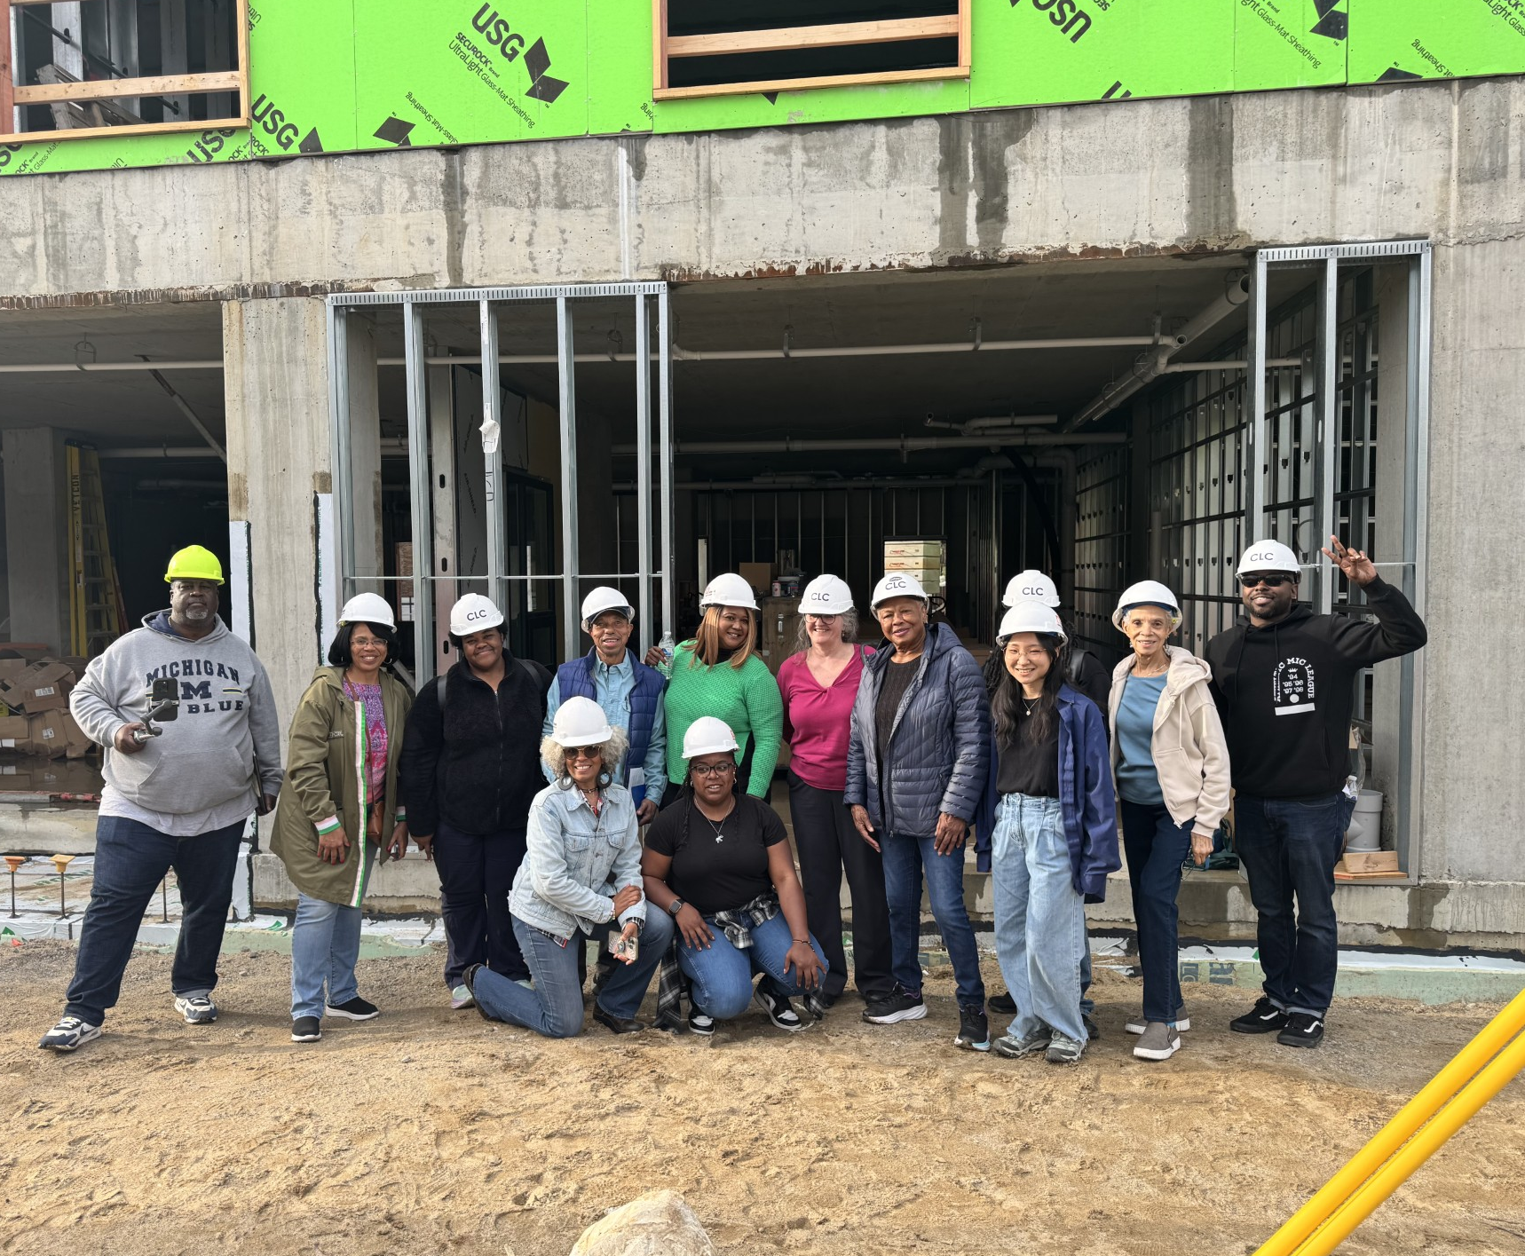
Community Leadership Council (CLC)
The CLC is a community advisory board that brings together multi-generational Black current and former residents of the neighborhood, including local Black artists and entrepreneurs.
Notes:
More photos or info

Slide 37
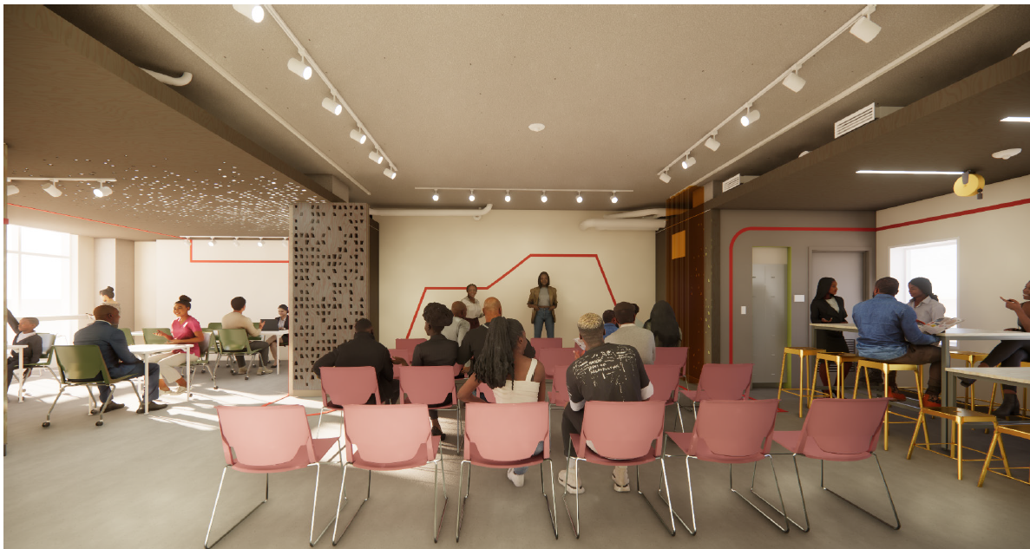
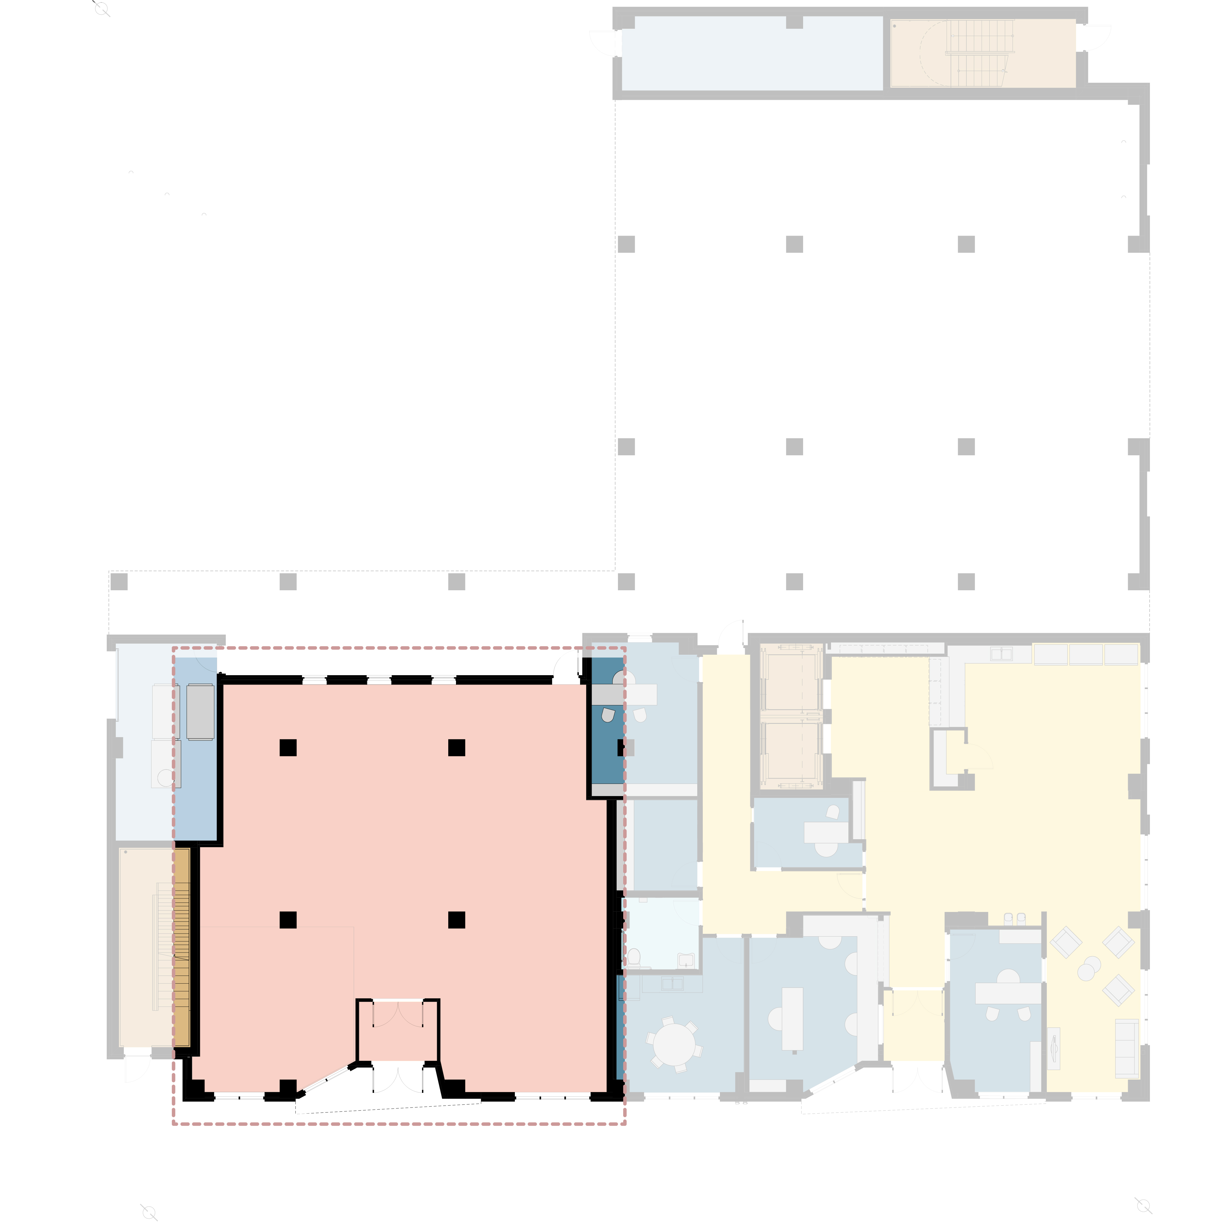
Celebrate & Honor the History & Culture of the Historically Black Neighborhood
CLC Public Community Space
2,096 sq ft
4TH AVE
CATHERINE ST

Slide 38
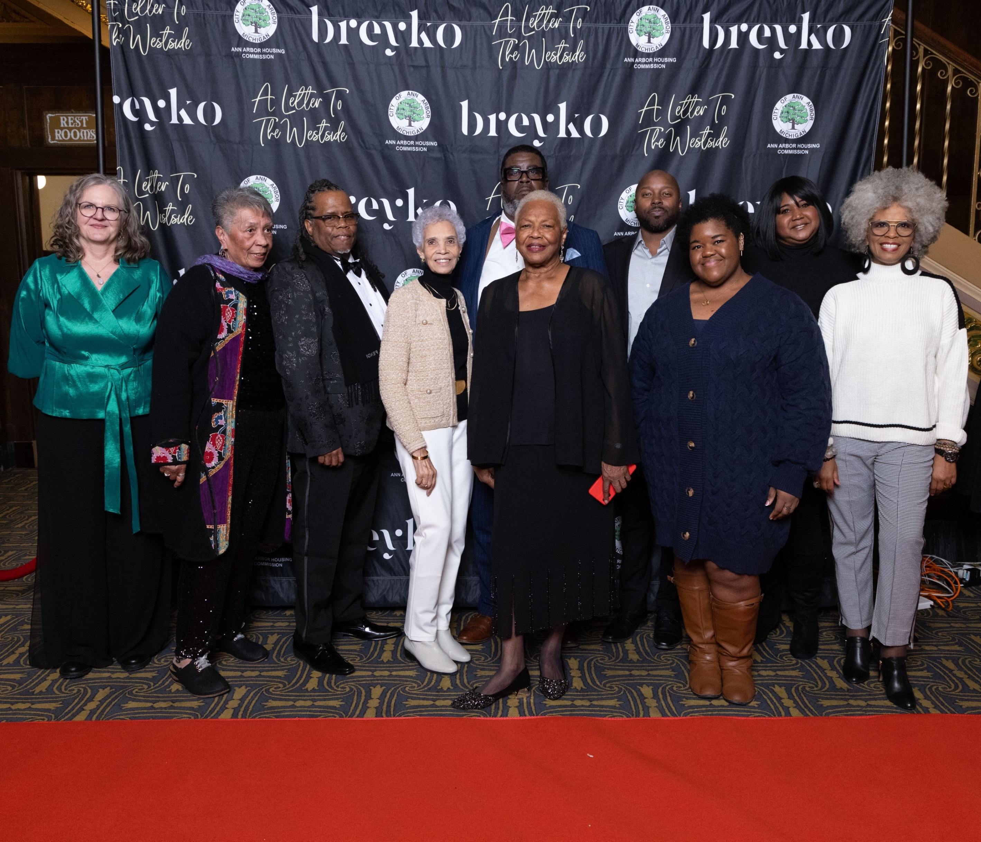
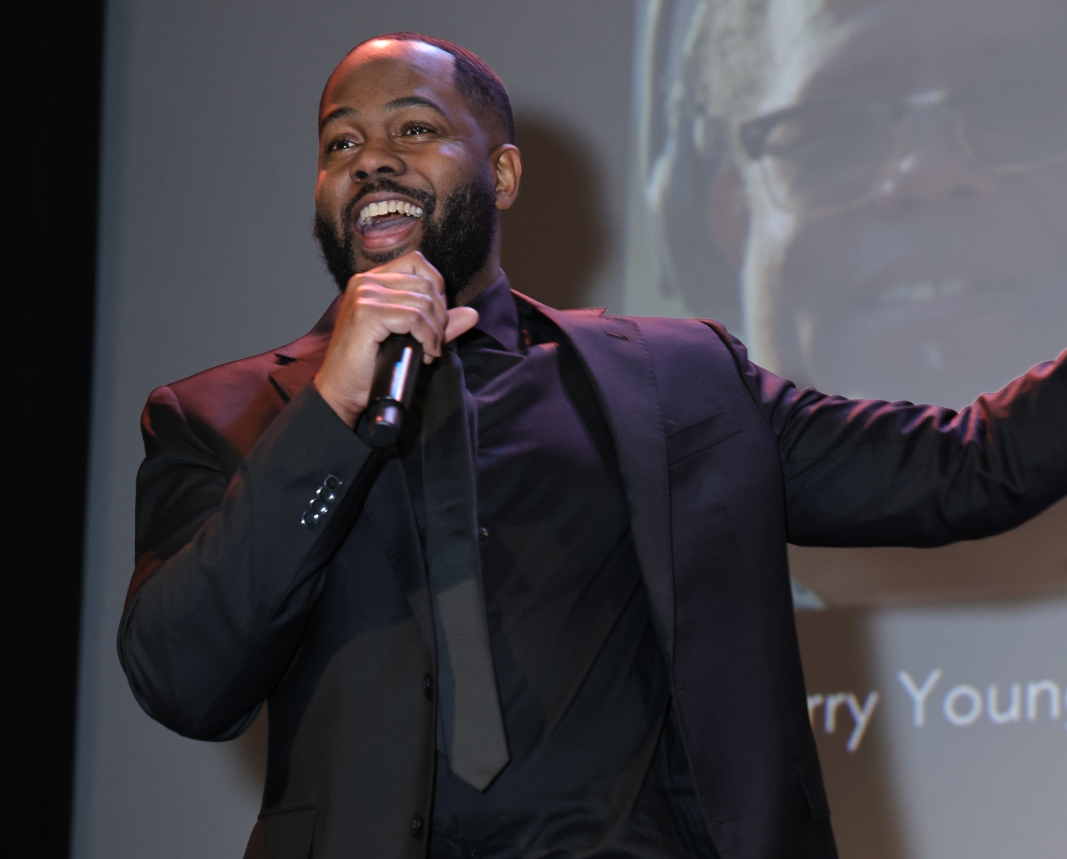

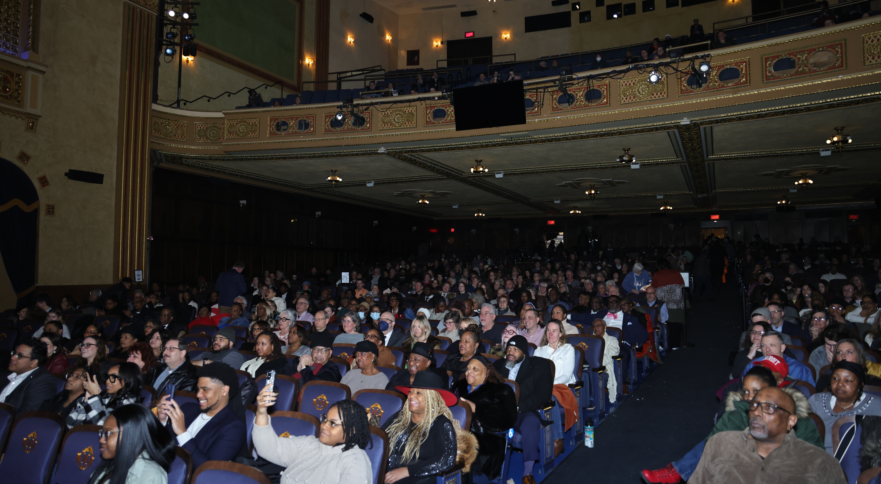
Documentary "A Letter to the West Side"
Click on title of film to watch

Slide 39
How is Affordable Housing Developed?
Must Secure Property
Need Patient Seller
Need to Secure Capital Stack
Multiple Funding Sources
Multiple Scoring Systems/Policy Preferences
Multiple Regulations
Need Public Support
Land
Funding
Reduced Taxes
Zoning
Development Budget
Land
Soft Costs (survey, appraisal, legal, inspections)
Hard Costs (new construction, renovations)
Reserves (Operating, Replacement, Lease-Up)
Developer Fee

Slide 40
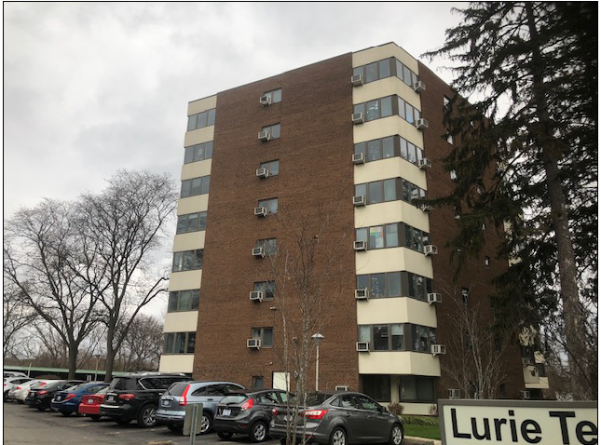
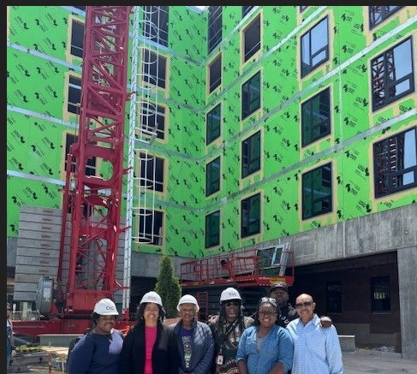
Development Options
Acquisition & Renovation - Lurie
New Construction – Dunbar
Notes:
One strategy is to acquire market rate properties and convert to affordable, which usually takes them off the property tax roles, which is an important municipal contribution to its affordability.
Or new construction to increase housing options. If the land is already publicly owned or owned by a tax-exempt entity, the property already has no taxes and you are not taking off the tax roll. If it is privately owned vacant land, then the taxes are already lower than if an existing building is removed from the tax roll

Slide 41
New Construction
Pros
Cons
Adding housing to the market
Can build sustainably
Can increase accessibility
No historic hazards like lead-based paint and asbestos
If built on public land or vacant land – little to no impact on property taxes
Can be more expensive per unit than acquisition/rehab
  Depends on property condition
  Preservation of existing affordable housing through acquisition, that would otherwise convert to market rate is critical
Longer time frame to completion
  5+ years concept to occupancy
Notes:
Currently trying to figure out how to raise $25M for Lurie Terrace renovations, which we acquired for $4M

Slide 42
Group Question
Do you think homeowners or renters receive more federal subsidies?

Slide 43
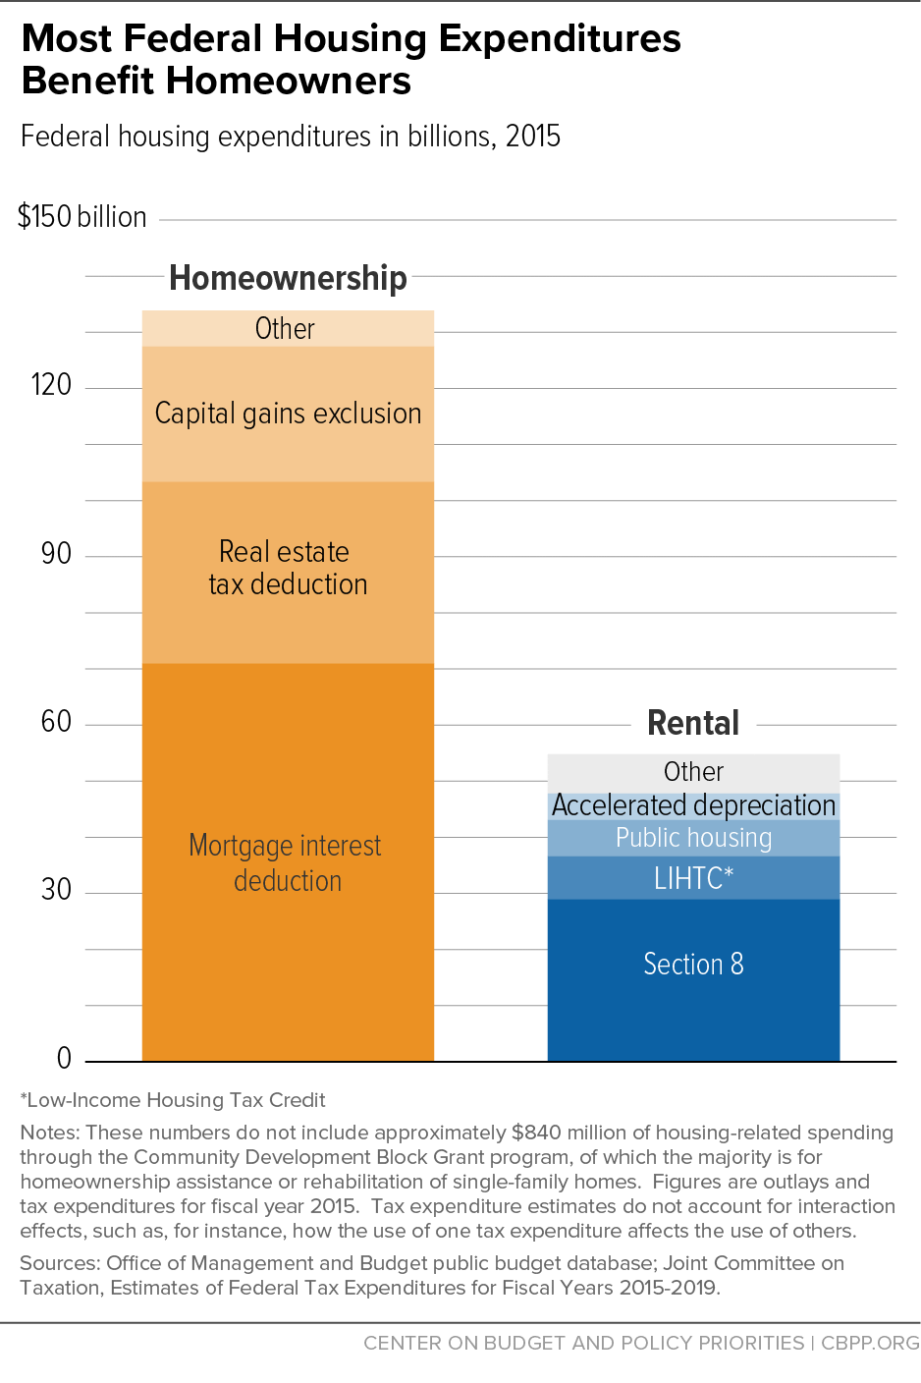
Federal Housing Programs
Notes:
HUD data – from the President’s Budget request 2024
IRS data – from the Joint Committee on Taxation (JCT)’s estimates of foregone revenues

Slide 44
Housing Development Costs are the Same for Market Rate & Affordable

Slide 45
Typical Development Financing is Different
Market Rate vs. LIHTC Affordable Housing
The biggest difference between market-rate development and affordable housing development is how it is financed
Market Rate
LIHTC 60% AMI Average
LIHTC (Non-profit developer)
30% AMI, 50% AMI & 60% AMI

Slide 46
Operating Revenue & Expense
Market Rate vs. Affordable
ROI = Return on Investment

Slide 47
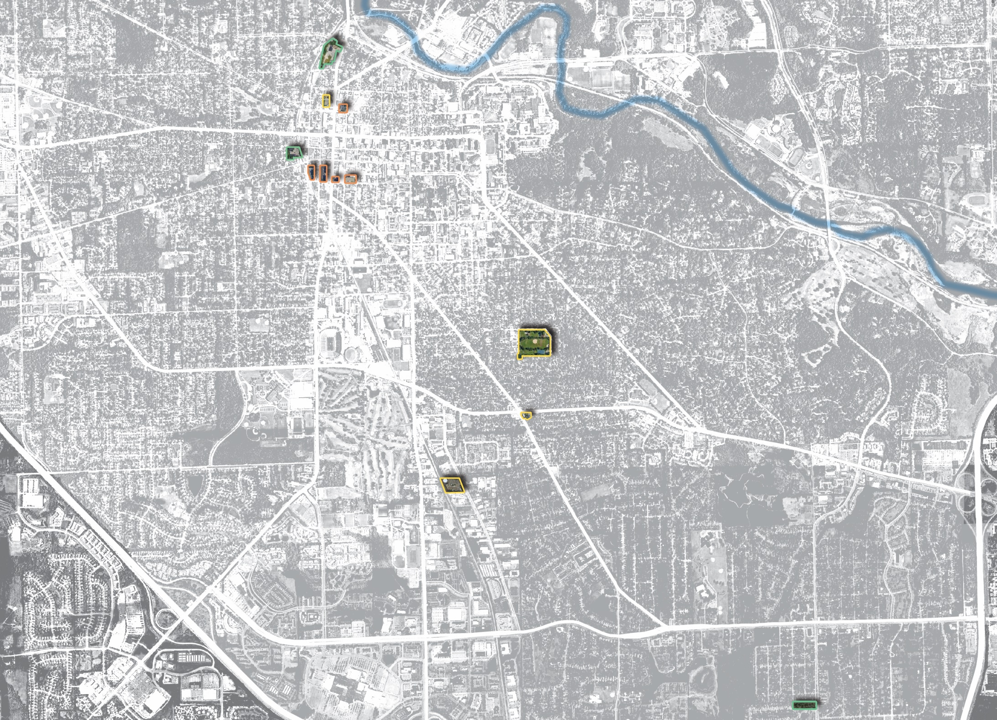
City-Owned Potential Housing Sites
721 N. Main
121 Catherine
Huron Ave
404 – 406 N Ashley
350 S. Fifth Ave
415 W. Washington
216 W. William
353 S. Main
Washtenaw Ave
Building / Facilities
1320 Baldwin Ave
Stadium Blvd
104 -120 W. William
Surface Parking Lots
State St
Main St
Stadium Blvd
1510 E. Stadium
Ann Arbor Saline Rd
2000 S. Industrial
Packard St
Vacant Properties
US 23
Packard St
3432 - 3440 Platt & 3435 – 3443 Springbrook
Eisenhower Pkwy

Slide 48
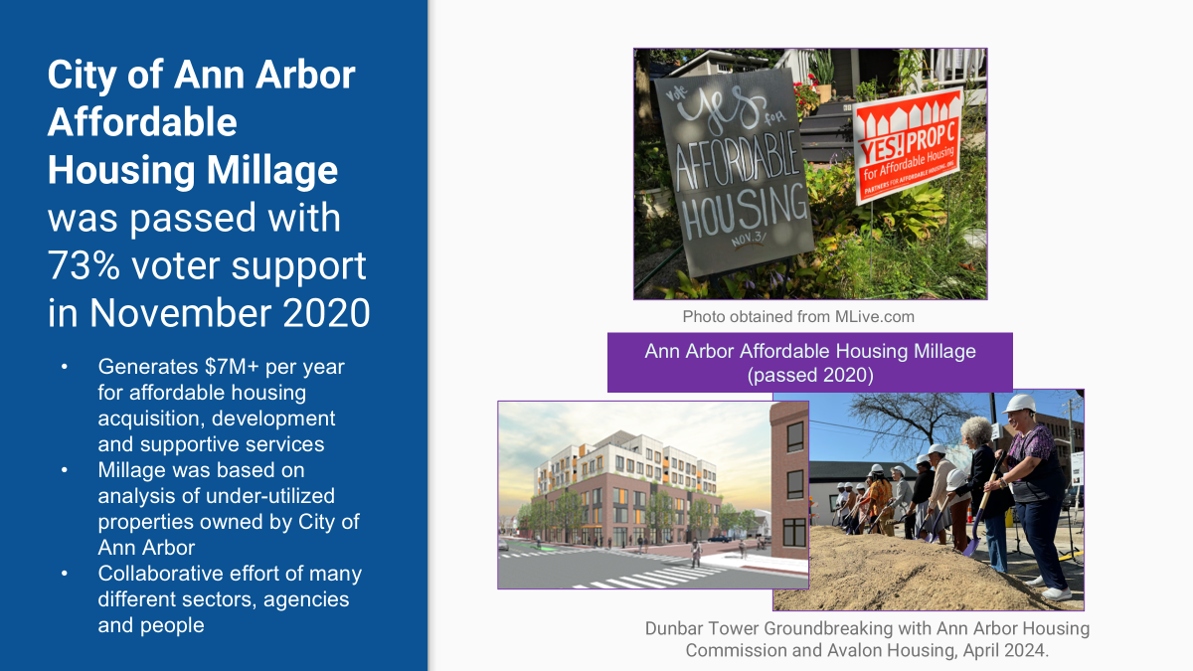
Notes:
We talked about doing a millage for 20+ years and were worried it would not pass. However, it passed in every voting precinct with 73% of the vote Many people in community – built coalitions – did poll of community. Lots of volunteers getting information out. WE CAN DO THIS TOGETHER

Slide 49
CHARTER LANGUAGE
SECTION 8.25. In addition to any other amount which the City is authorized to raise by general tax upon real and personal property by this Charter or any other provision of law, the City shall, in 2021 through 2041, annually levy a tax of up to one mill on all taxable real and personal property situated within the City for the purpose of building, maintaining, and acquiring new affordable housing units which are permanently affordable to low-income households making no income up to 60% of area median income and providing social services, not to exceed 20% of the millage revenues over the entire term of the millage, for the residents of such housing. No money collected pursuant to this millage shall be spent on building, maintaining, or acquiring new units located in the floodplain or floodway.

Slide 50
Affordable Housing Millage Guidelines
Adopted by City Council
July 27, 2020
Resident Services
Mental Health
Physical Health
Financial Services
Job Skills & Employment
Daily Living Skills
Crisis Management
Conflict Resolution
Youth Programming
Socio-Economic Diversity
All Neighborhoods
100% Affordable
Mixed-Income
Group Homes
Apartment Complexes
Inclusive & Equitable
Special Needs Seniors
Persons with a Disability
Youth Aging out of Foster Care
Homeless

Slide 51
Millage Guidelines Adopted by City Council
Sustainability
Energy Efficient
Green Construction
Net Zero
Development
New Construction
Acquisition
Demolition
Infrastructure
Utilities
Renovations
Permanent Affordability
Publicly-Owned Properties
Ann Arbor Housing Commission
Mission Driven Non-Profits
Cooperatives
Owner Models with Permanent Affordability
Leverage
Maximize Other Resources
Philanthropic
Public/Private

Slide 52
Affordable Housing Millage Strategy
Develop budget that includes AAHC projects in pipeline, including city-owned properties
Build in flexibility to acquire properties unexpectedly on the market
Application process for non-AAHC projects
Based on City Council adopted millage guidelines
Ensure investment in feasible projects with qualified developers
Capital Funds/Resident Services Funds
Capital funds drawn down first and one time
Services funds drawn down second and will require annual budget approval
Need to track ongoing annual service requests tied to capital projects

Slide 53
New Affordable Housing
Millage-funded Projects
Completed, 199 apartments
70 @ Hickory Way I & II, Avalon
50 @ Grove at Veridian, Avalon
16 @ Siller Terrace, AAHC
63 @ Dunbar Tower, AAHC
Under Development, 1017 apartments
39 @ Hickory Way III, Avalon
250 @ Annex@A2, The Annex Group
209 @ Arbor South, AAHC
330 @ 350 S 5th, AAHC
66 @ Lockwood on State, Lockwood
123 units @ 2 sites in process of acquiring, AAHC
Total Development Costs
$512,481,107
Ann Arbor Housing Millage
$68,629,369
13.3%
$424,591/unit average
Notes:
114 @ 800 Victors Way
9 Golden
404 N Ashley
123 W Summit
potential

Slide 54
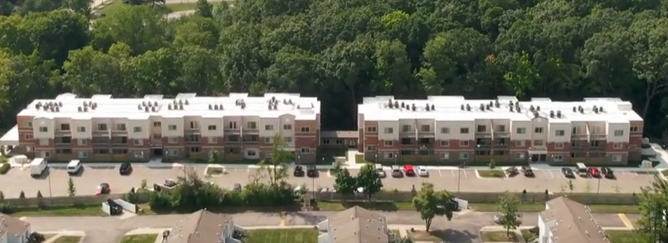
Hickory Way on S. Maple – Avalon Housing
3 Phases – 109 units
  34 units Phase I - Completed
  36 units Phase II – Completed
  39 units Phase III – Design Phase
  All 1 bedroom
Mixed Income
  30% AMI & reserved for households who are homeless or special needs with Project-Based Vouchers (PBV)
  50% AMI
  60% AMI
$38M Total Development Costs
  $2,025,000 city millage capital
  $800,000/year services
  Phase III Land Donated by City of A2
When the first two phases of Hickory Way opened, the rate of adult chronic homelessness in Washtenaw County fell 30%.

Slide 55
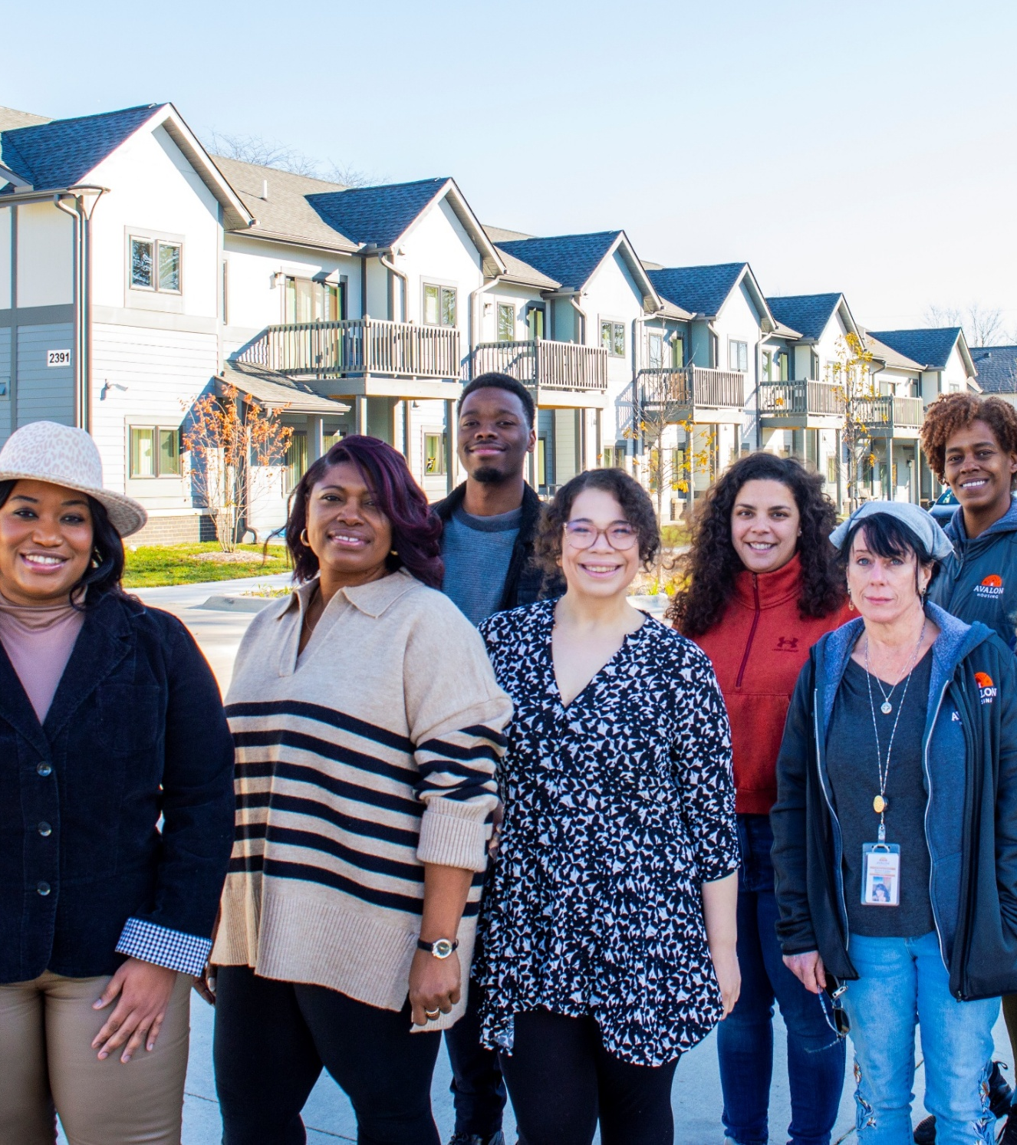
The Grove at Veridian on Platt – Avalon Housing
50 affordable apartments
  1 to 4 Bedrooms
  30 units up to 30% AMI & reserved for households who are homeless or special needs and they all have project-based rental vouchers
  20 units up to 60% AMI
115 people housed
$20.6 Million Total Development Costs
  $1.9 million city millage capital
  $389,000/year services
  Land Donated by Washtenaw County

Slide 56
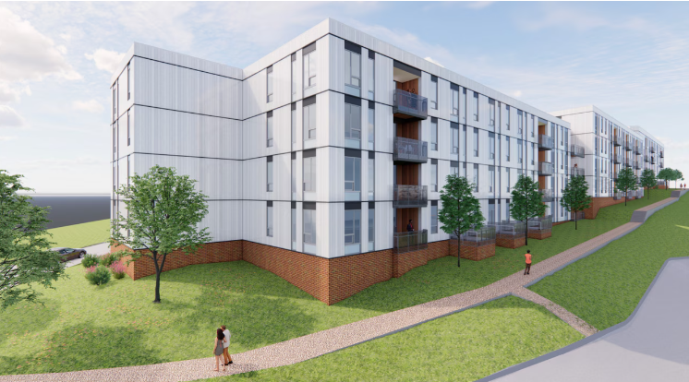
The Union @ A2 – The Annex Group
250 apartments, 30%, 60%, 70% AMI
1 - 3 Bedrooms
$78 Million Total
$3 Million City Housing Millage
Notes:
45 units at the 30% Area Median Income Level
1-3 bedrooms offered at $649 - $886
73 units at the 60% Area Median Income Level
1 bedrooms offered at $1,347
132 units at the 70% Area Median Income Level
1-3 bedrooms offered at $1,579 - $2,176

Slide 57
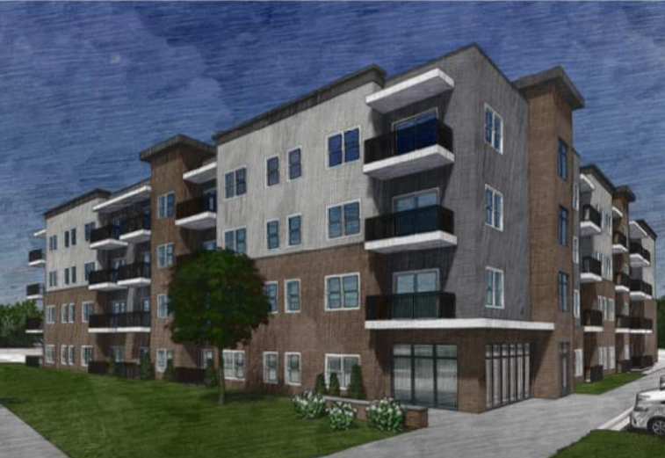
3689 S. State - Lockwood
66 affordable apartments
  44 1-bedroom
  22 2-bedroom
  5 AAHC project based vouchers for 30% AMI
  Also 50%, 60%, 70% AMI
$29 Million Development Costs
  $1.5 million city millage loan

Slide 58
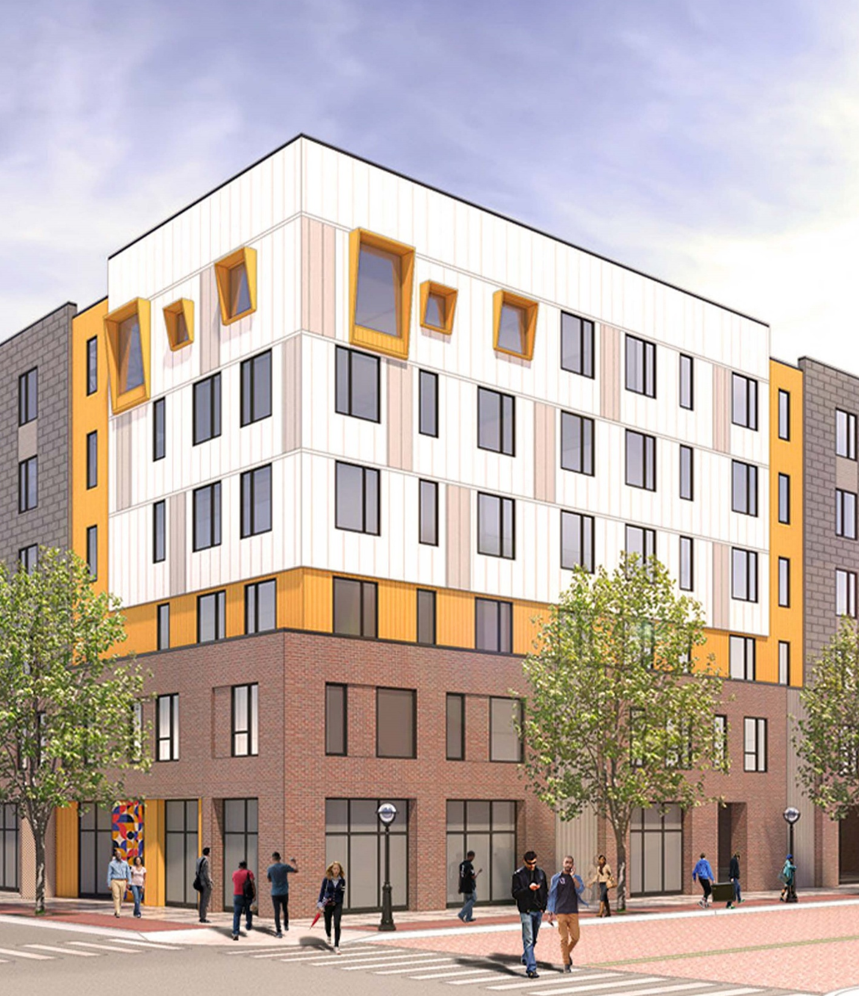
Dunbar Tower on Catherine – Avalon & AAHC
63 affordable apartments
  62 1-bedroom, 1 2-bedroom
  32 units reserved for people who are homeless with PBV
  31 units are at 50% or 60% of AMI with a preference for income qualified artists
$33.7 Million Total Development Costs
  $11.2 million city millage capital
  $305,000/year services
Move in Feb – May 2026
Land Donated by City of Ann Arbor
Notes:
Rents without PBV are $650-$900/mo including all utilities

Slide 59
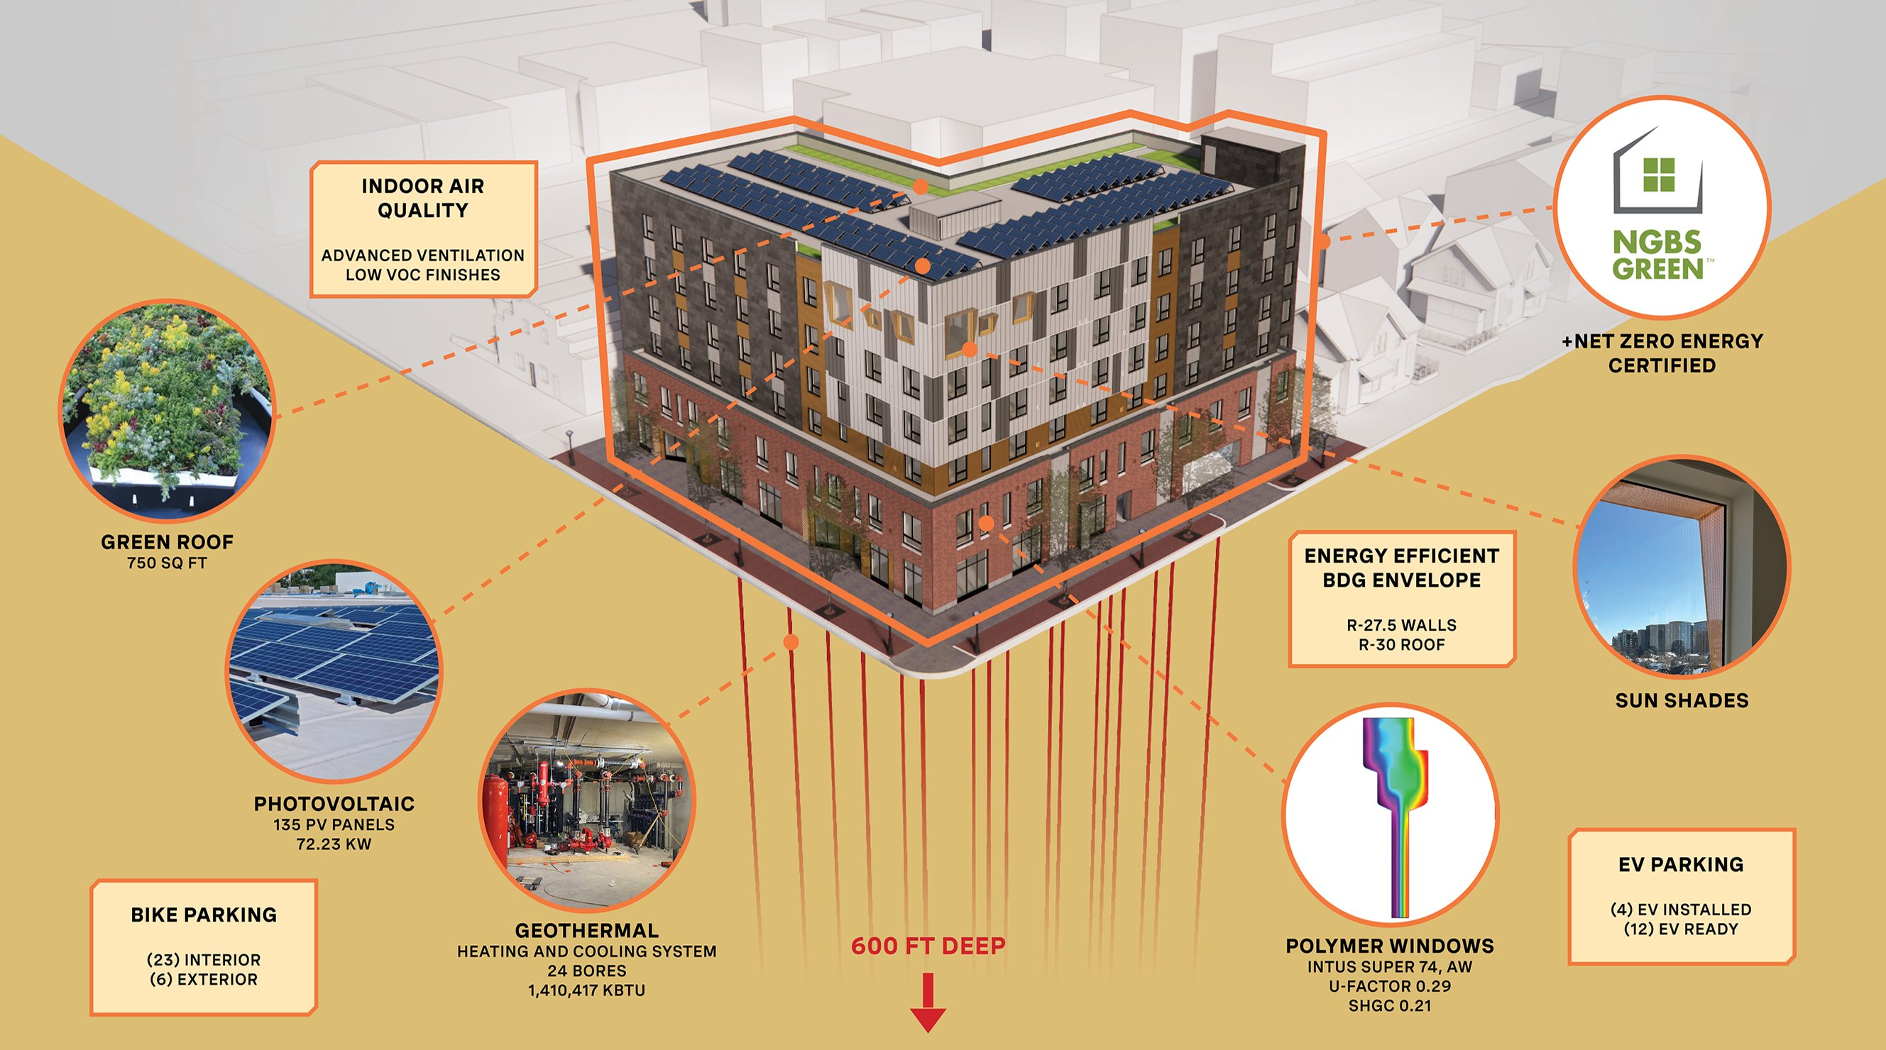
Sustainability

Slide 60
121 Catherine Funding Sources
Total Development Sources | $33,772,787
LIHTC Equity | $12,748,725
City of Ann Arbor Bond Financing | $9,000,000
HUD HOME (Washtenaw County) | $2,163,112
State MEDC RAP Grant | $4,018,915
Downtown Develop Authority | $650,000
City Housing Millage | $1,925,669
WCBRA Brownfield Funding | $959,406
State EGLE Brownfield Funding | $1,000,000
Federal Home Loan Bank | $458,872
IRA Geothermal Tax Credit | $254,975
General Partner Capital | $118,113
City of A2 Climate Millage | $475,000

Slide 61
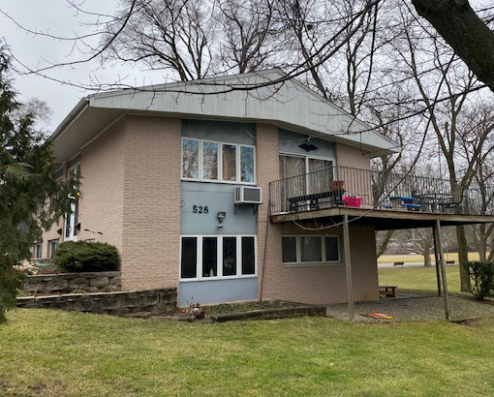
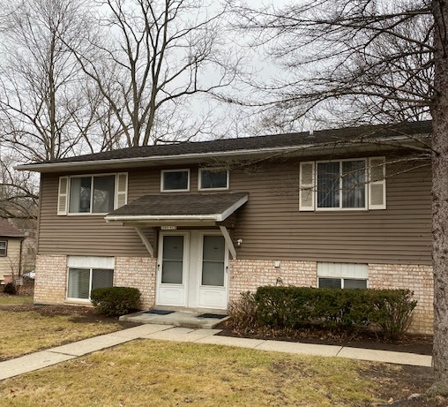
Siller Terrace - AAHC
Acquisition & Rehab 2023
2Bdr & 3Bdr duplexes
16 apartments
Mixed Income
  All 60% AMI or less
  As initial renters move out
$5,078,700 Development
  $78,700 city millage
Notes:
Siller Terrace

Slide 62
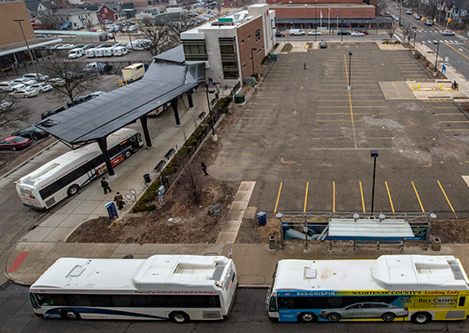
AAHC Project 350 S 5th
Partnership with Related Midwest
Notes:
19 stories
900% FAR
No parking

Slide 63
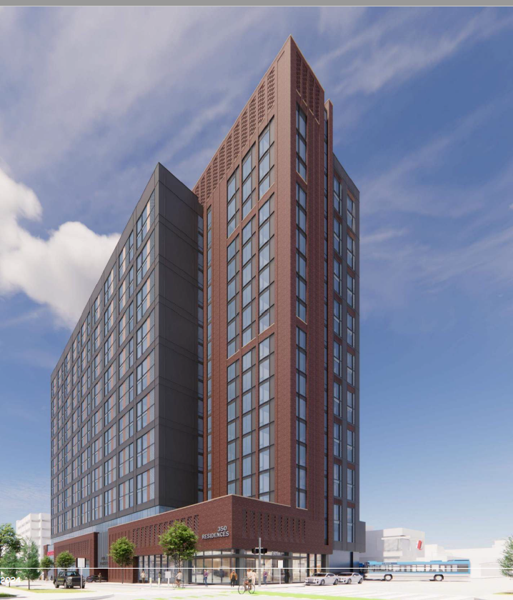

AAHC 350 S 5th
With Related Midwest
20 Story Tower
1Bdr & 2Bdr
330 apartments
Mixed Income
  110 @ 30% AMI with project based vouchers
  Also 60%, 70% & 80% AMI
$220,000,000 Development
  $35 million city millage bond
Construction 2026-2028
Notes:
Avalon is an example of nonprofit partnerships and now I am going to talk about for-profit partnerships
The AAHC is co-developing and co-owning this property with Related Midwest

Slide 64
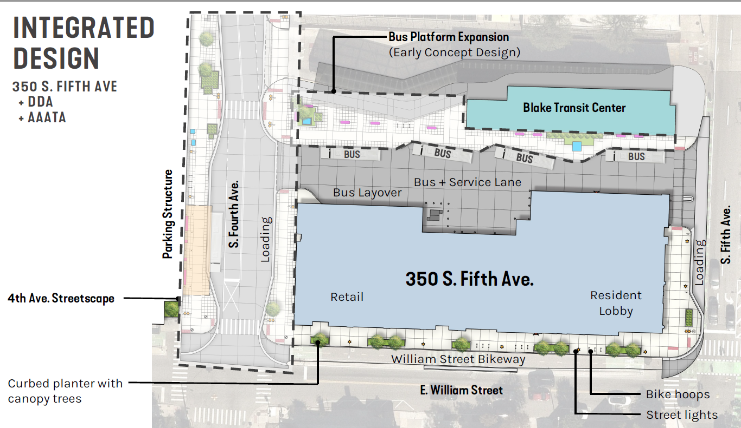
Notes:
If not familiar with the site, next to the Blake transit center and we are providing space for the AAATA to expand its bus platform so that buses can load and unload on both sides of the Blake. And we are also partnering with the DDA to integrate our design with their redesign of 4th ave

Slide 65
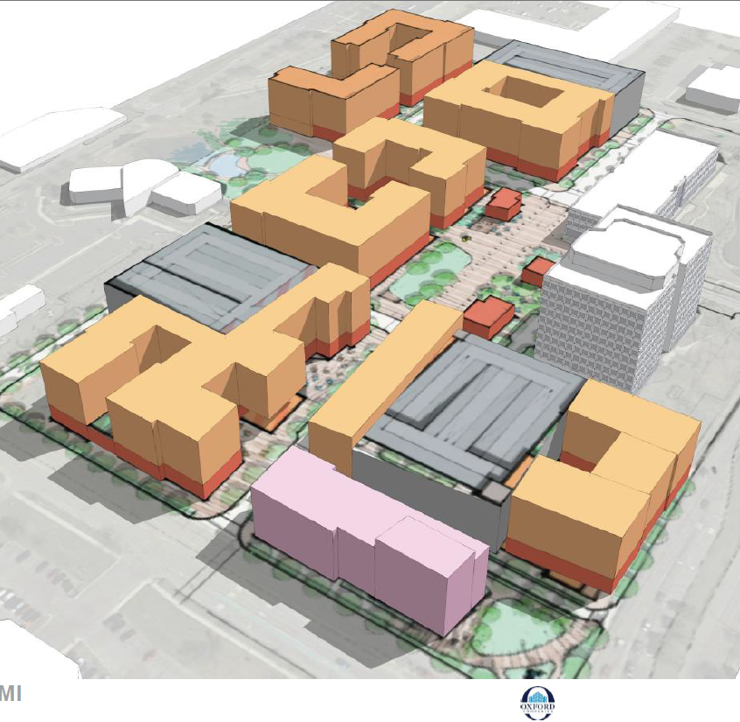
Arbor South
Hotel
Retail
Parking structures
800 market rate units
  Condos
  Rental
Requesting Brownfield TIF Financing, which requires 15% of the units to be affordable
209 affordable apartments
  151 (15%) required by developer
  60% AMI or less
AAHC will own the Affordable Units
$77 Million Development Costs for the Affordable Units
  $13 - $18 million city millage
  For additional 58 apartments
Notes:
Because we are exceeding the 15% required affordable units by over 50 units, we will be contributing city millage funds as well.

Slide 66
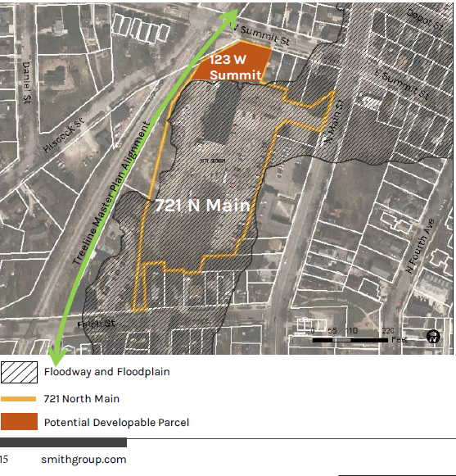

721 N Main/123 W Summit
5 -12 apartments
Townhomes or 2 – 3 story stacked flats
All affordable to households up to 60% AMI
Notes:
Difference between this site and W Washington. In addition to floodway/floodplain, EPA grant that demolished a building and EPA restricts redevelopment of any buildings from being developed in the floodway or floodplain

Slide 67


404 - 406 N Ashley
353 S Main

Slide 68



1510 E Stadium
Ann Arbor City owned
Fire Station #2
Notes:
Looked at townhomes and 3-4 story building as well as reuse of existing building. May need to temporarily relocated AAHC staff there while 2000 S. Industrial developed

Slide 69

2000 S. Industrial Hwy
Platt & Springbrook

Slide 70
2022 AAHC
NEW HUD DESIGNATION:
LANDLORD INCENTIVES COHORT #4
MOVING TO WORK
Competitive Process
29 Public Housing Authorities Designated under Cohort #4
139 PHA’s total approved for MTW Designation
Benefits
Regulatory flexibility
Funding fungibility & flexibility
5-year Study
Increase landlord participation in voucher program
Increase lease-up success for participants

Slide 71
MTW Implementation
Tenants
  Address barriers such as credit score or lack of credit
  Security deposit assistance
  Utility deposit assistance or utility arrears payments
  Housing search assistance
  Renter’s insurance allowed
  Initial move-in essential household items like beds, towels, kitchen supplies
  On-line tenant portal: rent payments, income certifications, waitlist, communications

Slide 72
MTW Implementation
Landlord Recruitment & Retention
  Pre-inspection of units
  Incentives for new landlords
  Incentives to retain landlords
  Assist with repairs to apartments
  Unpaid rent mitigation fund
  Vacancy payments between tenants
  Holding fees
  On-line landlord portal: payments, inspection status, communications

Slide 73
Yes
We Can
Develop
Affordable Housing

Slide 74
FINAL Group Question
Talk about something you have learned so far today that you did not previously know

