Slide 1
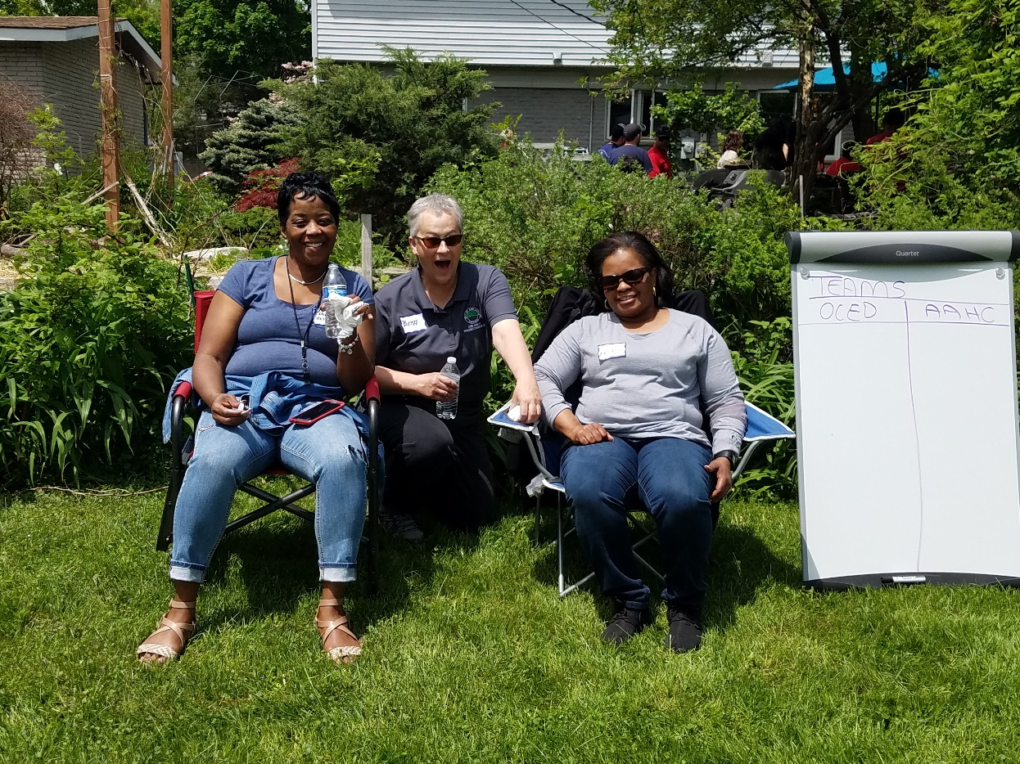
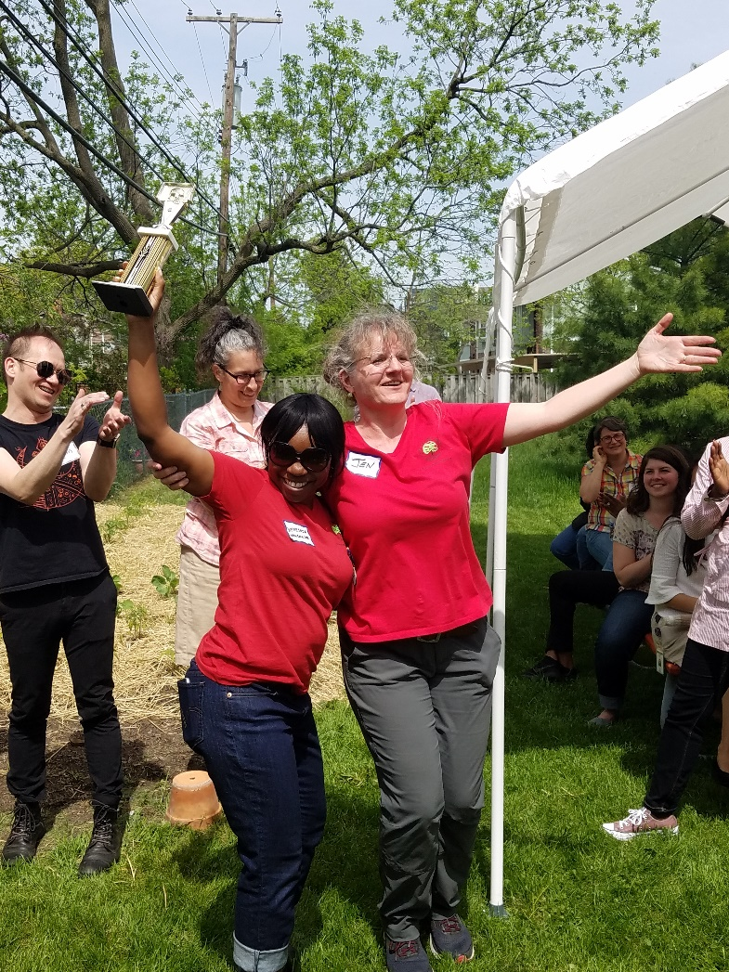
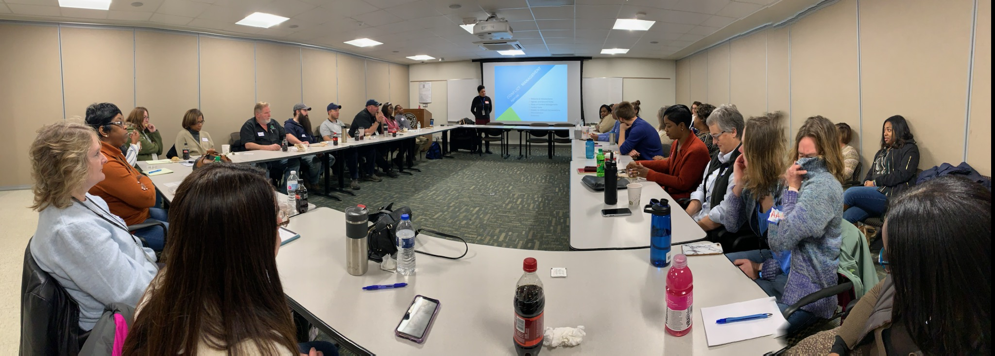
Ann Arbor Housing Commission

Slide 2
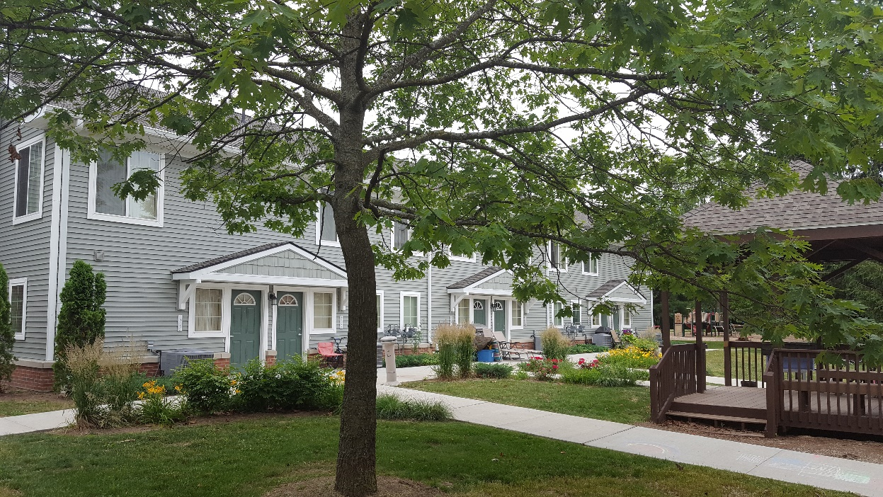
WHAT IS AFFORDABLE HOUSING?
Housing that costs less than 30% of a household’s gross annual income. If housing costs (rent and utilities or mortgage, taxes & utilities) exceed 30%, it is considered a cost burden.
Notes:
Acknowledge housing is needed in all income ranges, sizes and styles, condos, rental, owner, single family etc.
No difference between Affordable and Worforce - marketing not definition
EITHER Income or age restricted or market rate
Only other clearly defined term is Permanent supportive housing
Income restriction by upper level of income range and inclusive of everything below
Rental or owner but primarily talking about rental today because people with low incomes primarily renters therefore also rent restriction
Miller Manor & Cranbrook Towers 100% low-income due to funding source requirements. Depending on financing, can do mixed-income with or without market rate housing.
Affordable vs. Workforce, Senior 55+, Mixed-income, Mixed Use, Permanent Supportive Housing
In the study – we identified need for 2,711 in A2 up to 60% AMI
If we use the same study to look at the need for units from 60-100% AMI, it would be an additional 3,748

Slide 3
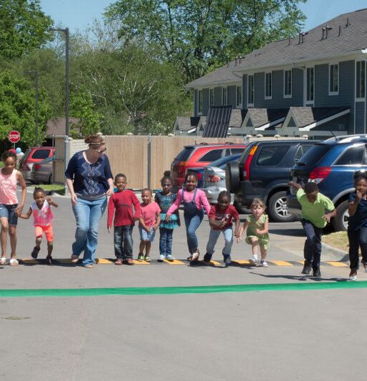
AAHC Services
01
Affordable Housing Properties
16 properties in the City of Ann Arbor
412 apartments
02
Voucher Programs
2,114 Vouchers
03
Family Self-Sufficiency & Homeownership Programs
99 – 130 FSS participants
9 Homeowners
04
Finance and Administration
$20 Million Budget
29 Staff
Open House West Arbor – Ribbon Running

Slide 4
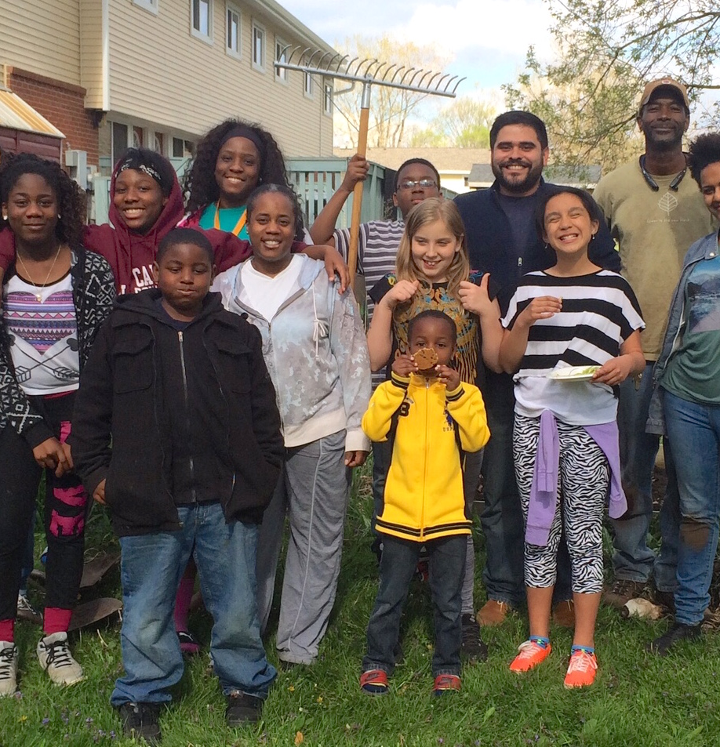
Affordable Housing
AAHC owner & property manager
235 1-bdr
60 2-bdr
74 3-bdr
29 4-bdr
14 5-bdr
100% Project-Based Rent Subsidies
30% of Income as rent
50% Area Median Income Eligibility
Hikone gardening program

Slide 5
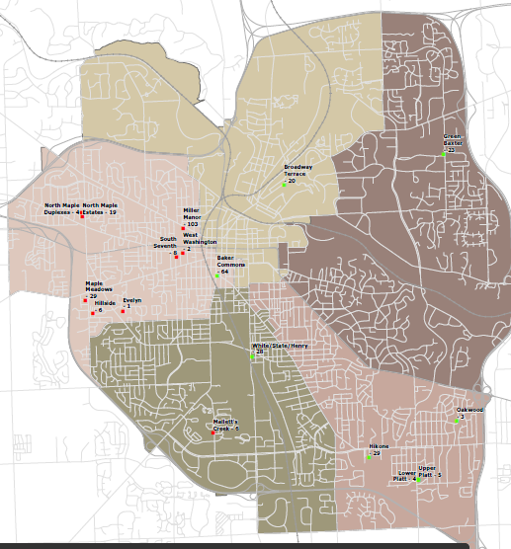
AAHC Resident Income

Slide 6
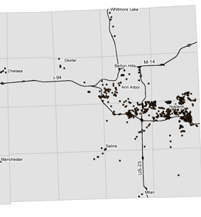
Voucher Programs
AAHC Administers
1,233 Housing Choice Vouchers
226 Veterans Affairs Supportive Housing (VASH) for Homeless Veterans
235 Non-Elderly Disabled Vouchers
32 Family Unification Vouchers
52 Continuum of Care Vouchers for Chronically Homeless Frequent Users of Emergency Services
336 RAD Project-Based Vouchers on AAHC properties
Rent Subsidy Private Sector
30% of Income as Rent
50% Area Median Income Eligibility
Distribution of AAHC Tenant-Based Vouchers in Washtenaw County

Slide 7
Finance & Administration

Slide 8
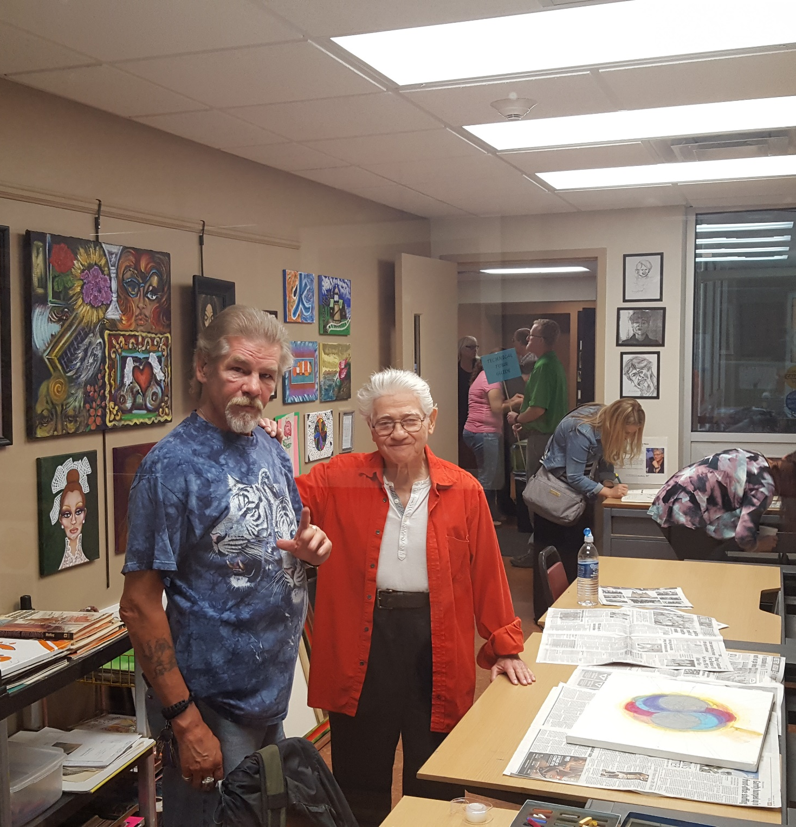
Supportive Services
Community Partners
Client-centered Case Management, Community Building, Crisis Services, Financial Literacy & Jobs Programs, After-School & Summer Youth Programs, Support Groups, Eviction Prevention, Quality of Life Services, Resident Council, Art Therapy
Ozone House
Peace Neighborhood Center
SOS Community Services
Food Gatherers
Michigan Works/Jobs Alliance
Community Action Network
Avalon
Housing
Veteran’s Administration
University of Michigan School of Pharmacy
Packard Community Clinic
Resident Art Room at Miller
www.a2gov.org

Slide 9
How are low-income residents impacted by the City of Ann Arbor’s Housing Market?

Slide 10
2019 Ann Arbor Area Median Income
Area Median Income | 1 Person | 2 Person | 3 Person | 4 Person | 5 Person
30% | $21,270 | $24.300 | $27,300 | $30,360 | $32,790
50% | $35,450 | $40,500 | $45,550 | $50,600 | $54,650
60% | $42,540 | $48,600 | $54,660 | $60,720 | $65,580
80% | $56,720 | $64,800 | $72,880 | $80,960 | $87,440
100% | $70,900 | $81,000 | $91,100 | $101,200 | $102,200
120% | $85,080 | $97,200 | $109,320 | $121,440 | $131,160
Ann Arbor Primary Metropolitan Statistical Area includes all of Washtenaw County – Median Family Income = $101.200; State of MI = $71,600
HUD places the Area Median Income into the 100% AMI 4 person household slot, and all other incomes are a formula based off that number

Slide 11
Affordable Monthly Housing Costs
Based on 30% of Income
Area Median Income | 1 Person | 2 Person | 3 Person | 4 Person | 5 Person
30% | $531 | $607 | $683 | $759 | $819
50% | $866 | $1,012 | $1,138 | $1,265 | $1,366
60% | $1,063 | $1,215 | $1,366 | $1,518 | $1,639
80% | $1,418 | $1,620 | $1,822 | $2,024 | $2,186
100% | $1,772 | $2,025 | $2,277 | $2,530 | $2,732
120% | $2,127 | $2,430 | $2,733 | $3,036 | $3,279

Slide 12
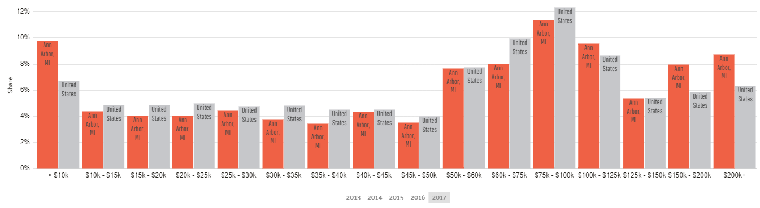
Ann Arbor 2017 Household Income Compared to USA
 | USA
 | Ann Arbor
Source: DATA USA, Ann Arbor, 2017

Slide 13
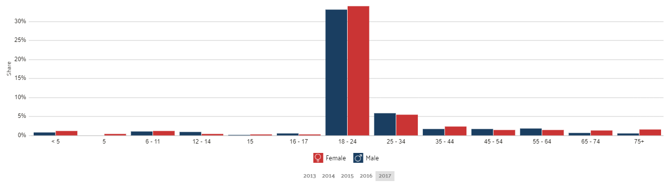
Ann Arbor 2017 Poverty by Age and Gender
Source: DATA USA, Ann Arbor, 2017

Slide 14
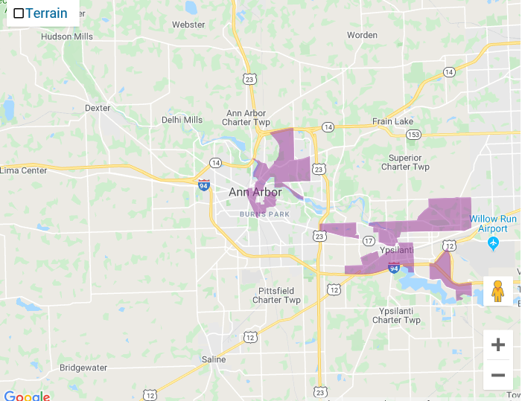
Poverty by
Census Tract
Source: 2019 HUD Office of Policy Development & Research

Slide 15
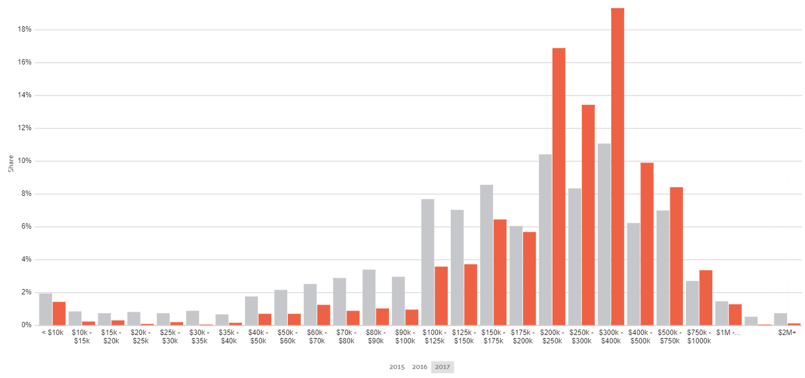
Ann Arbor 2017 Property Values Compared to USA
 | USA
 | Ann Arbor
Source: DATA USA, Ann Arbor, 2017

Slide 16
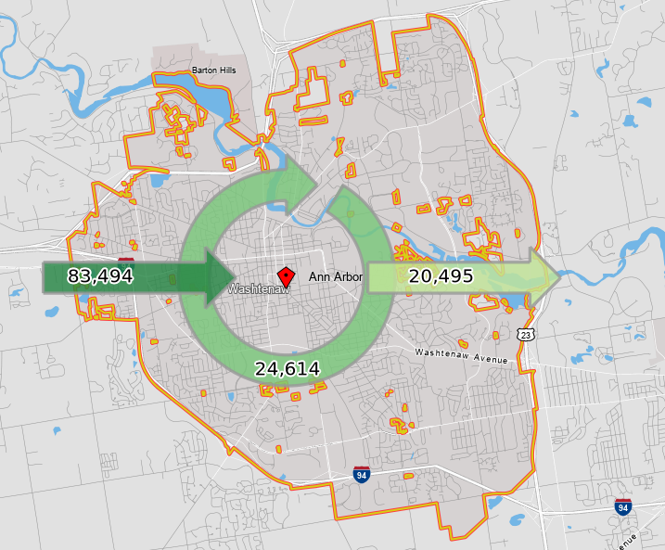
Commuting Patterns
83,494 commute in for jobs
24,614 live and work in Ann Arbor
20,495 commute out for jobs
Source: On the Map 2017
Notes:
2015 On the Map

Slide 17
Major Area Employers
COMPANY NAME | BUSINESS DESCRIPTION | EMPLOYEES
University of Michigan | Public University and Health System | 30,835
Trinity Health | Health Care System | 7,169
General Motors Milford Proving Grounds | OEM Research | 3,750
VA Ann Arbor Health System | Medical Center | 2,459
Ann Arbor Public Schools | Public School District | 1,907
Faureica North America | Automotive Component Manufacturing | 1,850
Eastern Michigan University | Public University | 1,617
Integrated Health Associates | Medical Center | 1,268
Washtenaw County | Government | 1,260
Thomson Reuters | Software/IT | 1,200
Truven Health Analytics | Data and Information | 850
Grupo Antolin Interiors | Automotive Component Manufacturing | 800
The Summit America Corporation | Automotive Component Manufacturing | 800
Ford Motor Company | Automotive Component Manufacturing | 784
Domino’s Pizza | Headquarters | 734
City of Ann Arbor | Government | 729
Source: Ann Arbor SPARK (January 2017)

Slide 18
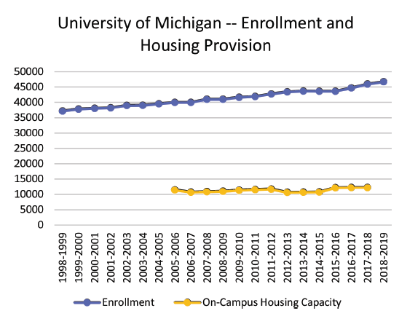
U of M Enrollment and Ann Arbor Population
U of M enrollment in 1999 – 37,846
U of M enrollment in 2018 - 46,716
Source: University of Michigan Enrollment and On-Campus Housing
Capacity for available date ranges. Enrollment data from Common Data
Set; housing capacity data from University Housing
Notes:
Students note 1.1 annual increase is fairly standard for U of M.
2007-2008 to 2017-2018 was 1.3%.
Info on
UM housed 37% of its undergraduates in academic years 2000-2001 through 2011-2012; that figure has
since fallen to 31% in the 2018-2019 academic year.

Slide 19
If there is such a huge demand for affordable housing, why isn’t the private sector building it?
Requires Subsidy
Limited
Resource
Market Driven
High Risk
Competitive
Site Specific

Slide 20
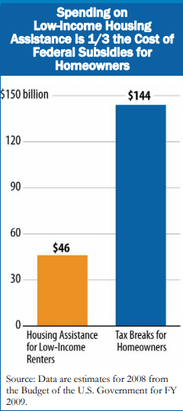
Federal Housing Programs
Housing & Urban Development (HUD) $42.7 Billion 2018
  Public & Indian Housing (1.2 million units)
  Project Based Section 8 & Housing Choice Vouchers (3.3 million units)
  HOME & CDBG
  Homeless & Special Needs Grants (443,000 units)
Internal Revenue Service (IRS)
  Mortgage Interest Deduction $146 Billion 2017
  Low Income Housing Tax Credits $9 Billion/yr (1.9 million units)
Notes:
IMPLICIT RACISM. History of public housing programs.
1930’s great depression, create decent housing and add jobs through construction. Controversial from start – private sector construction against govt intervention and thought they could provide whatever housing needed.
Local govt thought encroaching on local control. Local munis create PHA’s can decide if want low-income housing.
Income could not be more than 5x the rent. No rent subsidies. for every unit created, must demolish a substandard unit (removal of slums). Income limits set so that not competing with private housing market.
1937 public housing program created and at height 1.4 million units. currently 1.2 million
1940’s priority for war veterans not low-income.
1949 Act required over-income tenants to be evicted. Priority for people displaced by urban renewal, who were primarily people of color.
Greater opposition to new public housing as perception of whites against bringing in poor people of color. Segregated by race in PH.
1960’s civil rights and fair housing laws made it illegal to segregate by race or discriminate based on color. High rises no longer allowed due to fear of concentration of poverty.
1969 Rent capped at 25% of income, HUD started providing operating subsidies. Due to private market discrimination in housing and jobs and increase in white ownership and suburbanization, public housing tenants were more likely to be the people of color & poorer.
HUD new programs section 202 for seniors and section 223d3 for moderate income families.
1974 creation of section 8 rent subsidies because frustration with cost of developing and maintaining public housing.
s8 capped at 50% AMI whereas public housing capped at 80% AMI, though serving much lower incomes.
1981 further decline in funding and support for public housing. increased portion of rent to 30%.
1987 can only build new PH if can demonstrate not meeting demand with vouchers.
1990’s reform included FSS, HUD monitoring, HOPE IV, non-elderly disabled work requirement
1974 CDBG created in response to Nixon’s cuts to HUD. Block grants with less federal oversight & more local control. infrastructure, supportive services and owner & renter housing
Formula based on population, poverty, and over-crowded housing
HOME created in mid 1990’s low and very-low income housing funding. 25% matching funds
1987 Mckingey-Vento Act now known as Continuum of Care specifically for supportive housing for homeless households
Fannie Mae formed 1938 during Great Depression. Government sponsored entity (GSE) and Freddie Mac (1970) to purchases mortgages on 2ndary mortgage market, package and re-sell them as mortgage-backed securities or holds them.
own or guarantee more than 50% of the multi-trillion mortgages in US. Create liguidity for banks so can provide more loans – know will be purchased
IRS mortgage interest deduction created in 1913 to incentivize homeownership. Up to $1million loan plus up to $100K home equity. 2017 $146B estimated.
LIHTC created in 1986 (rate of return on investment #1 reason, tax shelter #2)
LIHTC so far created 2.97 million units but now 1.9 million Number 25% non-profit sponsored, 32% also have PBV

Slide 21
Committed Units lost in last 24 months
Name | Jurisdiction | Units | Type | End of Tenant Protection Period
Arbor Club Apartments (aka Woodchase) | Scio Township | 143 units | Family | 10/2/2019
Willow Ridge (aka Arbor Pointe | Pittsfield Township | 215 units | Family | 11/3/2019
Cross Street Village | City of Ypsilanti | 99 units | Senior | 8/30/2020
Lexington Club (aka Lynden Parke) | Pittsfield Township | 96 units | Senior | 4/1/2021
Huron Ridge | Ypsilanti Township | 144 units | Family | 3/5/2021
Huron Heights | Ypsilanti Township | 119 units | Family | 2022
 |  | 816 units
Increased rents have created opportunity for LIHTC projects contracted before 2005 have enabled property owners to take exemption from extended affordability periods – limiting affordability to just 15 years.
Notes:
Loss of about 15% of county AH stock in 18 months.

Slide 22
Housing Development Costs are the Same for Market Rate & Affordable

Slide 23
Typical Housing Development Financing
Market Rate vs. LIHTC Affordable Housing
The biggest difference between market-rate development and affordable housing development is how it is financed
Market Rate
LIHTC 60% AMI Average
LIHTC (Non-profit developer)
30% AMI, 50% AMI & 60% AMI

Slide 24
Operating Revenue & Expense
Market Rate vs. Affordable
ROI = Return on Investment

Slide 25
Development
Added 58 Apartments
Energy Efficient
Accessible & Visitable
Capitalized Reserves
Increased Asset Management
HUD Rental Assistance Demonstration Program conversion of Public Housing to Project Based Vouchers

Slide 26
City-Owned Sites
Downtown Sites
Outside Downtown
721 N Main
415 W Washington
404-406 N Ashley
350 S. Fifth parking lot (former Y)
S. Ashley/William parking lot
216 W William parking lot
Catherine/Fourth parking lot
353 S Main parking lot
2000 S. Industrial
1510 E Stadium
Platt & Springbrook
2857 Packard
1320 Baldwin

Slide 27
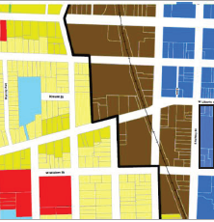
Land Use
Restriction
City Adopted Planning Documents or Council Resolutions
  Greenways & Treeline Trail
Zoning
  Density & Height
  Parking & Open Space
Deeds or Covenants
  FEMA (Federal Emergency Management Agency)
  MDEQ (Michigan Dept. of Environmental Quality)
  * Park Property
Plans
Zoning
Legal
* Park property requires ballot approval to convert to another use
www.a2gov.org

Slide 28
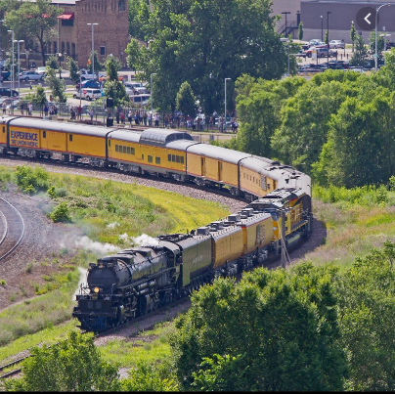
Environmental
Conditions
Floodway/Floodplain
Noise
  * Railroad within 300 feet of building
Underground Storage Tanks
Existing Buildings
  Asbestos Containing Materials
  Lead-based Paint
Brownfield Eligibility
Local
State
Federal
* Cannot use federal or MSHDA funds to build affordable housing within 300 feet of railroads

Slide 29
Financial
Modeling
Financial Resources
Building Characteristics
  Mixed Use
  Amenities
Tenant Characteristics
  Income Targets
  Number of Bedrooms & Unit Square Footage
Construction Costs
Financing Costs
  Loan Terms
Operating Cost Assumptions
* Low Income Housing Tax Credits (LIHTC)
Federal Housing and Urban Development (HUD)
Michigan State Housing Development Authority (MSHDA)
Ann Arbor Housing Fund (AAHF)
DDA Affordable Housing Fund
Brownfield Funding
Housing Revenue Bonds
Loans from Financial Institutions
Millage
Philanthropic Entities
Equity
Debt
Grants
Local
State
Federal
* LIHTC is by far the single largest source of funding for affordable housing in the United States for new developments
www.a2gov.org

Slide 30
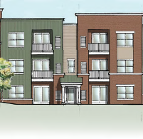
Other Considerations
Ownership Structure
  Homeowner, Rental, Cooperative
  For-profit, Non-profit
  Single Owner, Condo with Multiple Legal Entities
Market Demand
City Disposition Process
  Lease, Sell

Slide 31
Community Engagement
Process

Slide 32
Well-distributed cross section of participants
Stakeholder meetings
Workshops
  5 days, 20+ hours
  135 – 200 people
Website
  1,385 unique users
On-line survey
  302 unique responses
Range of Ages
Range of Incomes
89% Ann Arbor residents
All 5 wards represented
90% self-reported moderate to good understanding of affordable housing

Slide 33
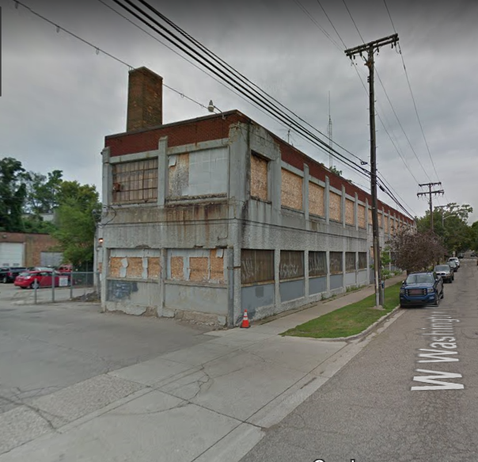
415 W Washington
Floodway/Floodplain
  Must Elevate Residential Use
  Greenway Eligible Use
Adjacent to Railroad
  NOT LIHTC Eligible
  NOT HUD or MSHDA Funding Eligible
Further Brownfield Study Needed
Chimney Swift Potential Disturbance
High Local Subsidy Per Unit
DDA Funding Eligible
c

Slide 34
Community Priorities
415 W Washington
ON-LINE RESPONSE – OBJECTIVES
Remediate any potential environmental contaminations
Connect to the Treeline Trail
Maximize affordable housing units for 60% AMI households on site
Preserve Chimney Swift Habitat
Provide additional uses (e.g. maker space, production space, office space, commercial space)
Sell the property and use proceeds for affordable housing on another city-owned property
Fit in with existing adjacent building heights and scales
Maximize park space
Fit in with existing setbacks along Washington Street
Provide adequate buffer to adjacent single family housing
Maximize market rate residential
WORKSHOP RESPONSE
to PHYSICAL MODELS
Fewer comments than for 350 S. 5th
Majority of participants emphasized maximizing affordable housing regardless of design/density implications
A few comments supporting “stepping down” development toward adjacent uses
A few comments supporting selling the property to support affordable housing elsewhere

Slide 35
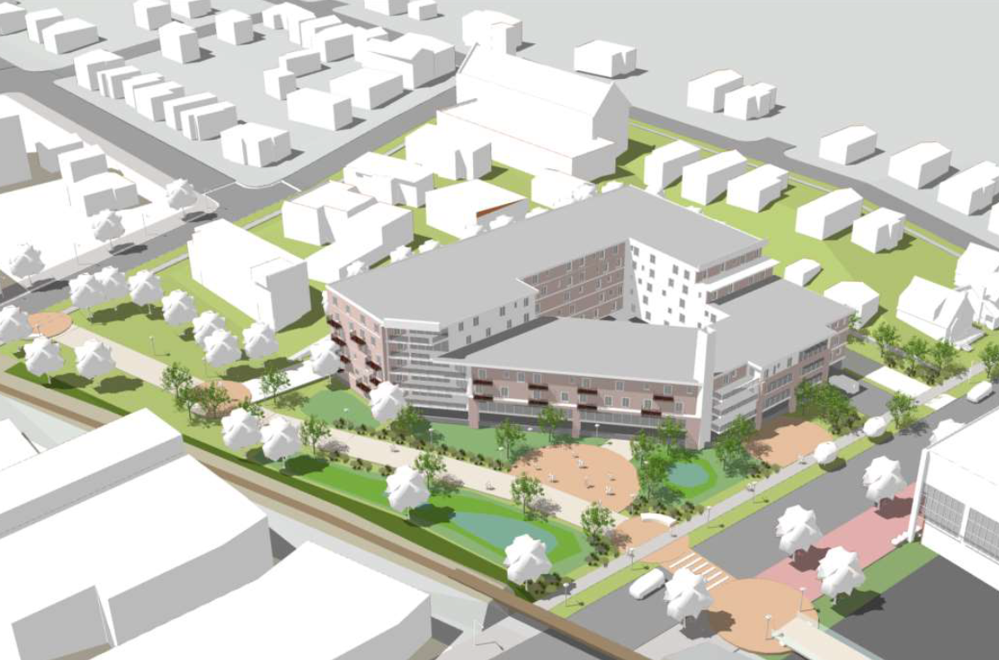
Appraised Value $5.5 Million
D2 Zoning
32,671 SF footprint
148,330 SF total
133% Floor-Area-Ratio
TDC ~$49 Million
Annual Tax ~$1.1 Million
Annual Lease~ $.05 - $1 M
173 Residential Units
# Units at 60% AMI - TBD
9,900 SF Commercial/Flex

Slide 36
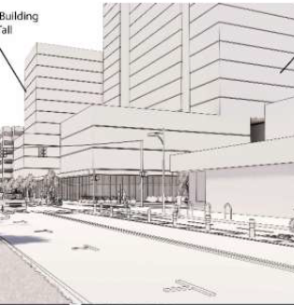
350 S. 5th (old Y)
c
No Negative Site Issues
LIHTC Eligible
  High Scoring
LIHTC Quickly Maxes Out Funding
  Large Number of Units
HUD and MSHDA Funding Eligible
DDA Funding Eligible
Significant Impact On Downtown
  AAATA Partner
c
c
c
Community Engagement Underway

Slide 37
Catherine/Fourth Lot
No Negative Site Issues
LIHTC Eligible
  High Scoring
  Perfect Size to Max Out Funding
    60 - 85 units
HUD and MSHDA Funding Eligible
DDA Funding Eligible
Minimal Local Resources Neede
Parking for Farmer’s Market
c
c
Recommend AAHC as Developer with Land Lease: Can Begin Design and Site Plan Approval Process Immediately

Slide 38
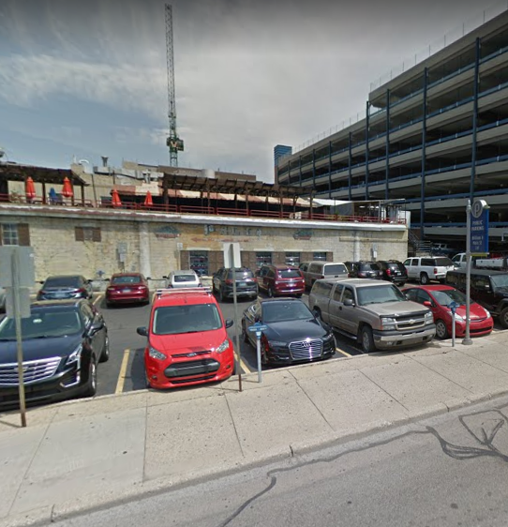
353 S Main
No Negative Site Issues
LIHTC Eligible
  High Scoring
  Perfect Size to Max Out Funding
    60 - 85 units
HUD and MSHDA Funding Eligible
DDA Funding Eligible
Minimal Local Resources Needed
c
c
Will make recommendation in January during council work session to develop

Slide 39
404 - 406 N Ashley
No Negative Site Issues
LIHTC Eligible
  High Scoring
  Perfect Size to Max Out Funding
    60 - 85 units
HUD and MSHDA Funding Eligible
DDA Funding Eligible
Minimal Local Resources Needed
UM Dental Clinic Lease Expires 6/2021
  Work with UM to Relocate
c
Recommend AAHC as Developer with Ground Lease: Can Begin Design and Site Plan Approval Process Immediately

Slide 40
S. Ashley Lot (Klines)
No Negative Site Issues
LIHTC Eligible
  High Scoring
LIHTC Quickly Maxes Out Funding
  400-600+ units
HUD and MSHDA Funding Eligible
DDA Funding Eligible
Significant Impact On Downtown
  Pair w/ Parking Deck 216 W William
c
c
Recommend Community Engagement: Height, Density, Parking, Income Target, Uses, Developer, Sell or Lease

Slide 41
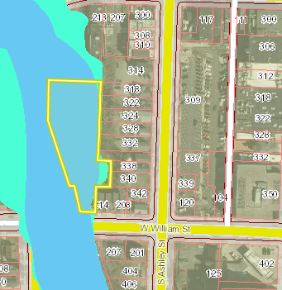
1st/W William Lot
Entire Site in Floodway/Floodplain
NOT LIHTC Eligible
  Adjacent to Railroad
NOT HUD & MSHDA Funding Eligible
DDA Eligible
Council Resolution re Greenway
c
Do Not Recommend Development as Affordable Housing

Slide 42
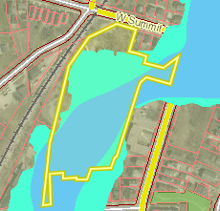
721 N Main
Floodway/Floodplain
  FEMA Deed Restriction
  Greenway, Treeline Trail Eligible Use
NOT LIHTC Eligible
  Adjacent to Railroad
NOT HUD or MSHDA Funding Eligible
DDA Funding Eligible
High Local Subsidy Per Unit
Northwest corner developable
  25-35 units
c
c

Slide 43
2000 S. Industrial
Underground Storage Tank
NOT LIHTC Eligible
  Adjacent to Railroad
NOT HUD & MSHDA Funding Eligible
Large Site – High Potential
  50-165 Units
Test Site Revenue Bond Financing
AAHC Office/Maintenance Relocation
High Local Subsidy Per Unit
c
c
Recommend AAHC Develop after Further Study: High Site Potential if Able to Finance with AAHC Revenue Bonds & Local Subsidy

Slide 44
Platt & Springbrook
No Site Issues
LIHTC Eligible
  Scores Poorly Based on Location
  Too Small for Stand-Alone LIHTC
    12-14 Units
HUD & MSHDA Funding Eligible
Expensive Infrastructure Per Unit
  Road
  Water and Sewer
High Local Subsidy Per Unit
c
c
c
Recommend Community Engagement: Developer, Density, Owner or Rental

Slide 45
1510 E Stadium
No Site Issues
LIHTC Eligible
  Scores Poorly Based on Location
  Too Small for Stand-Alone LIHTC
    8-12 Units
HUD & MSHDA Funding Eligible
Demolition of Fire Station
  Or Potential AAHC Office/Maintenance
    Temporary or Permanent
High Local Subsidy Per Unit
c
c
c
Recommend Further Study: Hire Architect to Design and Cost Estimate to Renovate & ADA Addition as Office/Maintenance Space

Slide 46
Next Steps Remaining Downtown Properties
Community Engagement
  Continue with SmithGroup
  Add Downtown Parking Study
  Add Downtown Housing Market Analysis
Development Due Diligence
Present designs to City Council for pre-entitlement
RFP/RFQ for developer
  Include community goals
  Include community resources

Slide 47
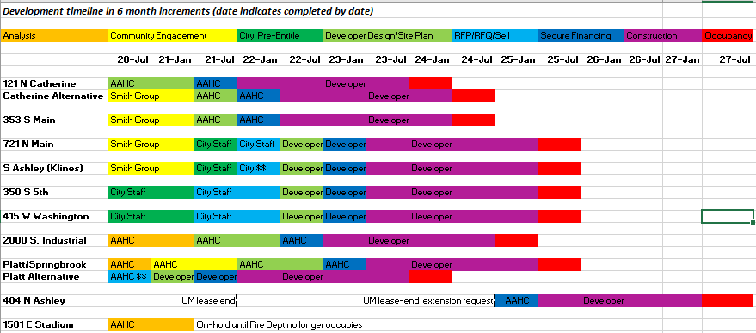
Timeline

